Slide 1

PCI DSS Compliance Training
Matt Packard, CCEP | Compliance and Ethics
mpackard@uwf.edu | 850.857.6070

Slide 2
Agenda
PCI DSS Overview
The Basics
Your Responsibilities
University Policies
Best Practices

Slide 3
So.. What is PCI DSS?
Payment Card Industry Data Security Standards
Created by the PCI Data Security Council (Visa, MasterCard, American Express, Discover, and JCB)
Created a common set of industry standards developed to increase the controls around cardholder data to reduce credit card fraud.
These standards consist of 6 goals and 12 Requirements…

Slide 4
PCI DSS Standards
Six (6) Goals | Twelve (12) Requirements
1. Build and Maintain a Secure Network and System | Install and maintain a firewall configuration to protect cardholder data Do not use vendor supplied defaults for system passwords and other security parameters
2. Protect Cardholder Data | 3. Protect stored cardholder data 4. Encrypt transmission of cardholder data across open, public networks
3. Maintain a Vulnerability Management Program | 5. Protect all systems against malware and regularly update anti-virus software or programs 6. Develop and maintain secure systems and applications
4. Implement Strong Access Control Measures | 7. Restrict access to cardholder data by business need to know 8. Identify and authenticate access to system components 9. Restrict physical access to cardholder data
5. Regularly Monitor and Test Networks | 10. Track and monitor all access to network resources and cardholder data 11. Regularly test security systems and processes
6. Maintain an Information Security Program | 12. Maintain a policy that addresses information security for all personnel

Slide 5
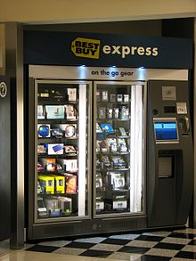
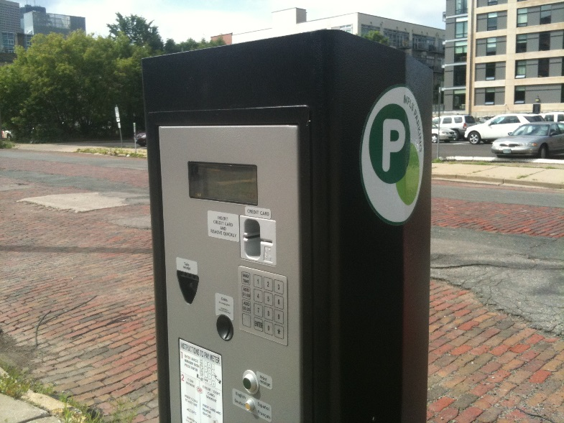
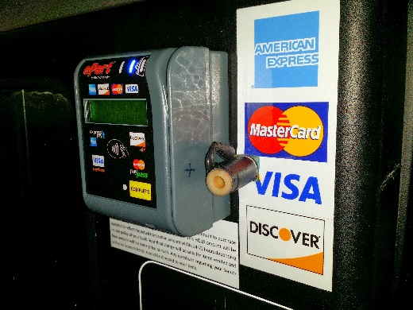
Background Information
Over the past few decades…
Increases in payment card usage
Increases in e-commerce
Increases in more “convenient” payment methods

Slide 6
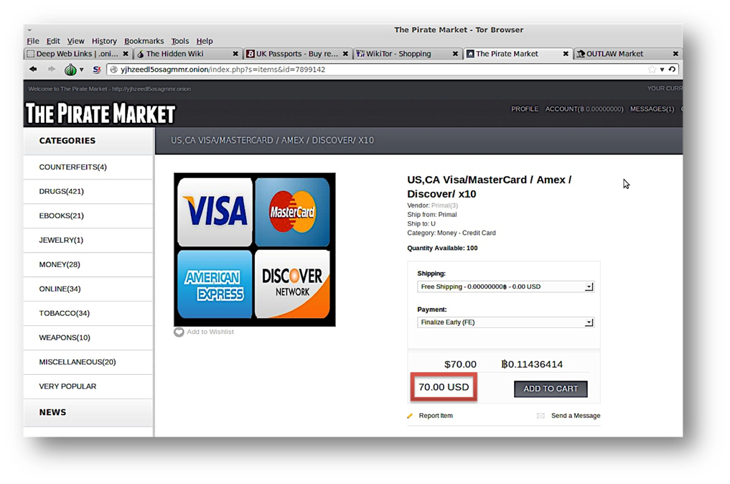
Background Information Continued
In our desire for convenience, we have left ourselves vulnerable

Slide 7
PCI DSS @ UWF
As a public institution we have a obligation to our students, vendors, donors, stakeholders, and the community at large to ensure that there account information is safe when processing credit card payments @ UWF

Slide 8
Non-Compliance—What’s at Stake
Could result in the revocation of our ability to accept card payments
Causes damage to consumer trust and our reputation
Fines our acquiring bank $5,000 to $100,000 per month*
$7.01 million = Average organizational cost of a data breach**
*The bank will likely pass this fine along…
**2016 Cost of Data Breach Study: Global Analysis, Ponemon Institute

Slide 9
Agenda
PCI DSS overview
The Basics
Your responsibilities
University Policies
Best Practices

Slide 10
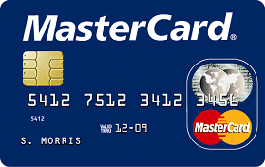
The Basics: Credit Card Anatomy (Front)
EMV Chip
Holographic Security Emblem
Account Number
Expiration Date
Cardholder’s Name
Card Logo

Slide 11
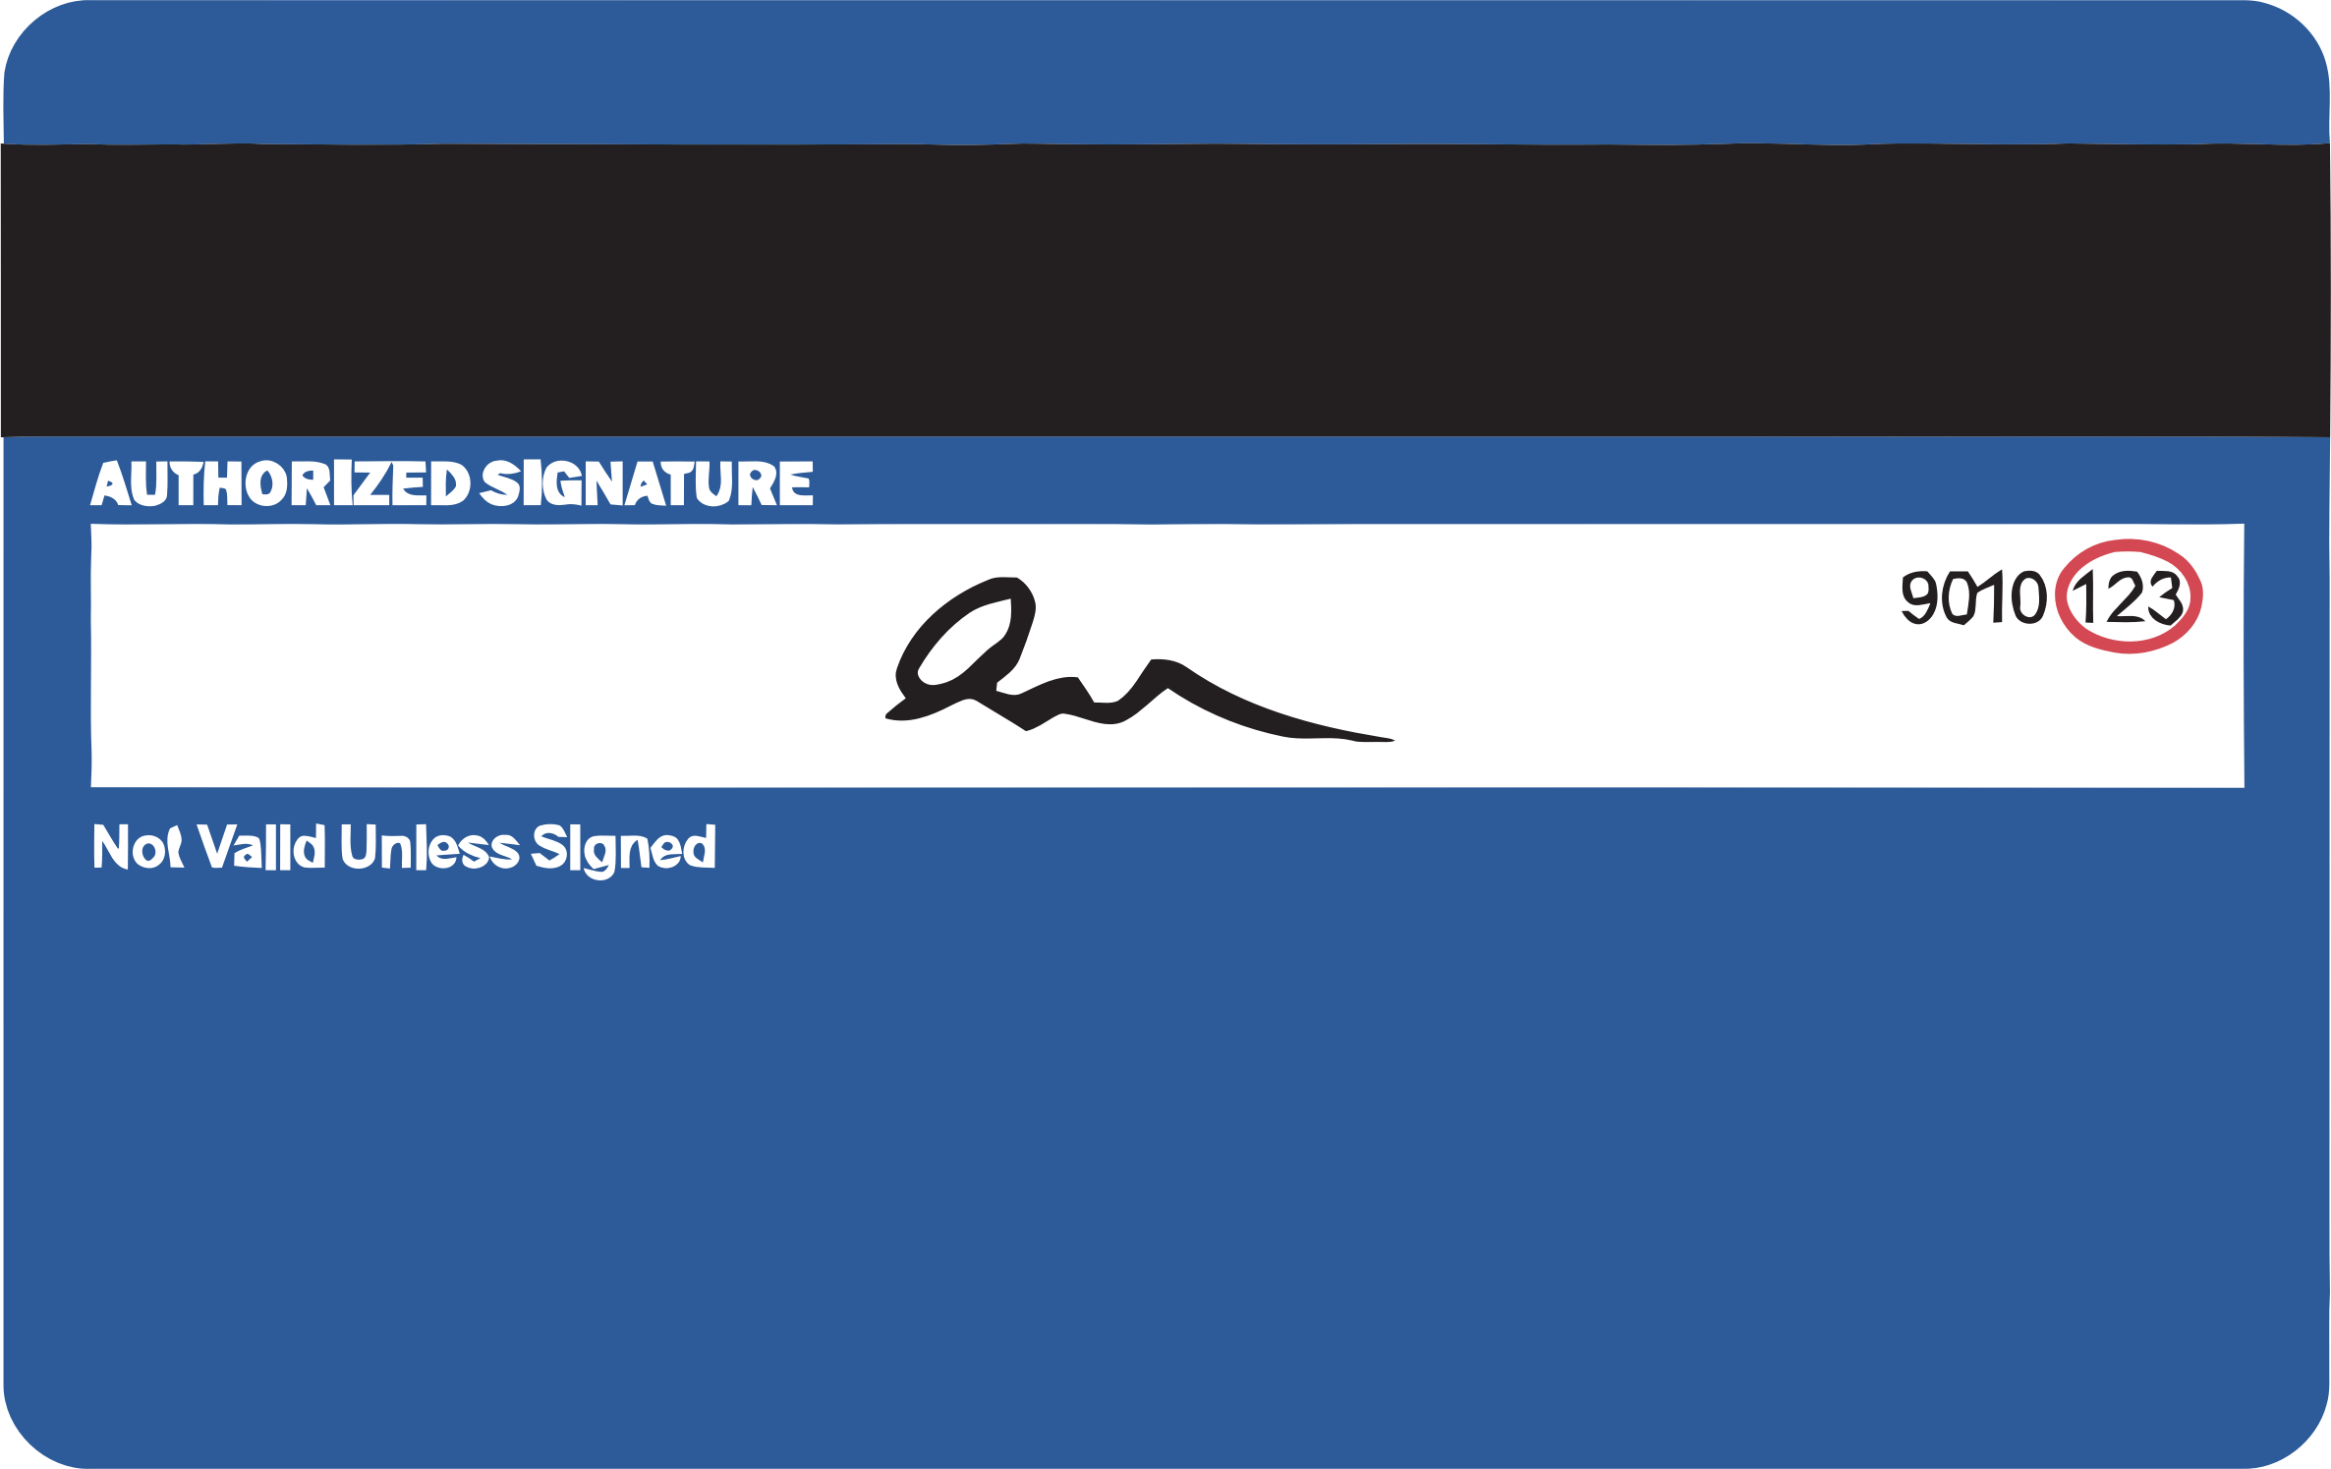
The Basics: Credit Card Anatomy (Back)
Security code also known as CVV2/CID*/CAV/CVC2
Magnetic Stripe
The magnetic stripe contains Cardholder name/address; account #; expiration date; and security information to detect fraudulent cards
*American Express refers to this code as the CID and it is located on the front of the card

Slide 12
What is Cardholder Data (CHD)? … technically
Primary Account Number (PAN): Consists of the full credit/debit card number
CHD consists of the PAN plus any one of the following:
Cardholder name
Expiration date
Security Code

Slide 13
The Last Four Digits…
Storage of the last four digits of a credit card number is allowed & does not constitute cardholder data (CHD)
Customer receipts should never show any more than the last four digits of the credit card number
Computer systems and software used to process credit card transactions should not display more than the last four digits of the credit card number

Slide 14
Cardholder Data Procedures: Magnetic Stripe/PIN/Code
The University does not permit the storage of the codes found on the magnetic stripe, PIN/PIN block data, or the card validation code.

Slide 15
Cardholder Data Procedures: Access Control
All employees that have access to CHD must keep this information in the strictest confidence, and protect it from unauthorized access or disclosure.
Access to this information should be on a need-to-know basis only.

Slide 16
Cardholder Data Procedures: Access Control Cont’d
Anyone who is exposed to CHD must receive this training and sign-off on an agreement to uphold these standards
Afterwards you will be given individual access to a individual and specific ITS-approved payment portal
You may never share your credentials or sign in using some one else’s
This is referred to as Access Control and it limits the risk of fraud

Slide 17
Cardholder Data Procedures: Electronic Records
CHD should NEVER be stored in electronic format*
CHD should NEVER be included in email or other electronic messages
*Entering CHD into e-market portals (ex. HigherOne/CashNet/etc.) does not qualify. As this data is not being stored on our campus network.

Slide 18
Cardholder Data Procedures: Paper Records Procedures
Paper documents must be protected, stored securely, and disposed of securely.
Avoid the use of paper documents whenever possible.
If unavoidable, please refer to the paper document standards/procedures provided on the UWF Office of Compliance and Ethics PCI Compliance webpage.
This includes receiving prior authorization and cross-cut shredding of any paper documentation

Slide 19
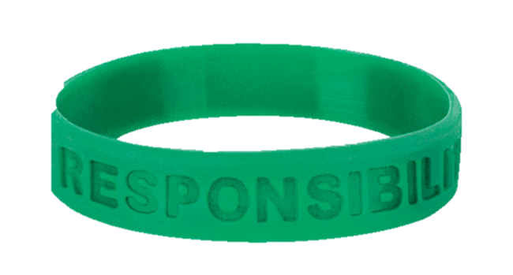
Agenda
PCI DSS overview
The Basics
Your responsibilities
University Policies
Best Practices

Slide 20
Workstation Responsibilities
Each workstation must be a dedicated, PCI compliant, ITS-approved payment machine
Each user is required to have a unique login for operating POS device
Keep login credentials confidential and do not share with others
Secure the credit card environment from non cashier personnel

Slide 21
Workstation Responsibilities Continued
Log off whenever stepping away from machine
Log off another cashier and login with your own credentials when processing transaction
Turn off POS device at night and secure area
Keep your workstation clear of any sensitive materials

Slide 22

Agenda
PCI DSS overview
The Basics
Your responsibilities
University Policies
Best Practices

Slide 23
UWF PCI DSS Policies
Official PCI DSS policies, training guides, and information is located on the Compliance and Ethics website, located under the PCI DSS sub-section listed on the right-hand side of the page.

Slide 24
PCI DSS Security Policy
Technologies NOT allowed to access / connect to the UWF PCI DSS cardholder environment
Open or public WIFI (non VPN)
Removable electronic media (USBs, etc.)
Laptops
Tablets
Smartphones

Slide 25
PCI DSS Security Policy Cont’d
Activities NOT allowed while accessing and/or connected to the cardholder environment
Checking email
Visiting any website not directly associated and pertinent to the actions being performed
Make internet or intranet connections that are not explicitly necessary

Slide 26
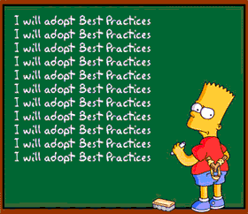
Agenda
PCI DSS overview
The Basics
Your responsibilities
University Policies
Best Practices

Slide 27
Best Practices
Maintain strong passwords and update regularly
Password Dos and Don’ts
Be on the lookout for skimming devices
Familiarize yourself with the point-of-sale equipment and check regularly for modifications
Be sure your station is physically secured at all times

Slide 28
Best Practices Continued
Destroy CHD immediately* (cross-cut shredder)
Notify the Compliance Officer or Financial Services immediately if there is a change in personnel
Never send CHD via electronic messages/email
Never share your login credentials
Be on the lookout for phishing/social engineering attempts to steal your credentials
Avoiding phishing and social engineering attacks

Slide 29
Questions, Comments, or Concerns? Please contact Matt Packard, Chief Compliance Officer
mpackard@uwf.edu | 850.857.6070

