Slide 1
UWF Building Emergency Coordinator Program
Emergency Management

Slide 2
Training Objectives
Explain the Building Emergency Coordinator (B.E.C.) program
Clarify roles and responsibilities
Provide program ground rules
Discuss information and resources for B.E.C. activities

Slide 3
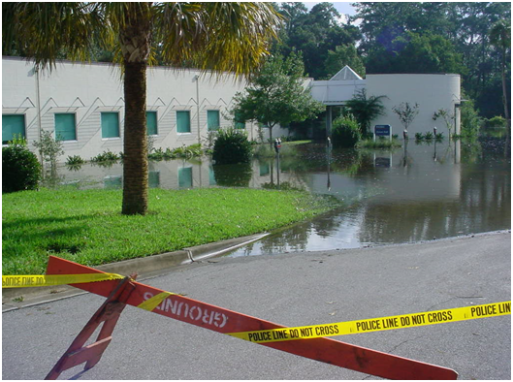
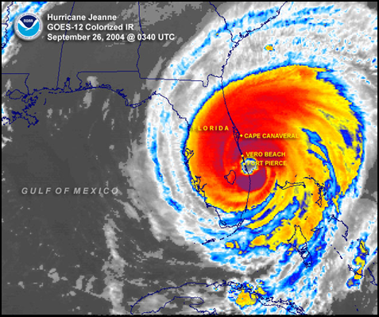
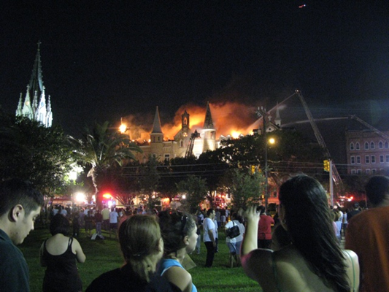
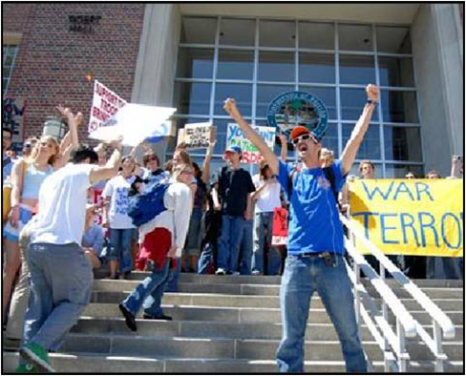
Why does UWF need B.E.C.’s?
Main campus includes ≈100 buildings on 1,600 acres plus several off-site facilities
Population of 17,000 + faculty, staff and students
Diverse campus facilities including academic buildings, health center, childcare, secure research labs, apartment-style housing, theaters, etc.
You know your building better than anyone! Incidents can happen at any time.

Slide 4
What is the B.E.C. Program?
Establishes a point of contact for each department/college with assigned space in a building.
Department/college assigns a primary and an alternate for occupied buildings, preferably someone who is on campus and in the building frequently.
Program is coordinated by the Emergency Management Department in conjunction with UWFPD and EH&S.

Slide 5
B.E.C. Roles and Responsibilities
Point of contact for safety & emergency preparedness information provided by UWF and other officials
Liaison with Emergency Management and other officials in the event of an incident at your building
Act as a Rally Point leader during building evacuations
Act as an information conduit for issues related to Facilities, (i.e., scheduled utility outages and building maintenance problems)
Assist in damage assessments with Facilities Management
Assist in Fire Drills and other safety and emergency exercises
Ensure completion of closure checklist and procedures prior to UWF closures
Read, follow and distribute B.E.C. email messages to your building occupants
Encourage all building occupants to download UWF Guardian App

Slide 6
B.E.C. Ground Rules
Do not put yourself or others in danger!
Follow all announcements from UWF and local officials
If your building is evacuated, only re-enter when deemed safe by public safety officials or UWF officials
Be a champion of preparedness in your building!

Slide 7
Issued Equipment
In the event of an Emergency, the B.E.C. should be able to be readily recognized.
B.E.C. Safety Vest
  Stripes and words are reflective even in low light
Flashlight
  Can be secured to vest or other surfaces
  Can be used as a signaling device
Safety Whistle
  Can be used as a signaling device
Other equipment as necessary

Slide 8
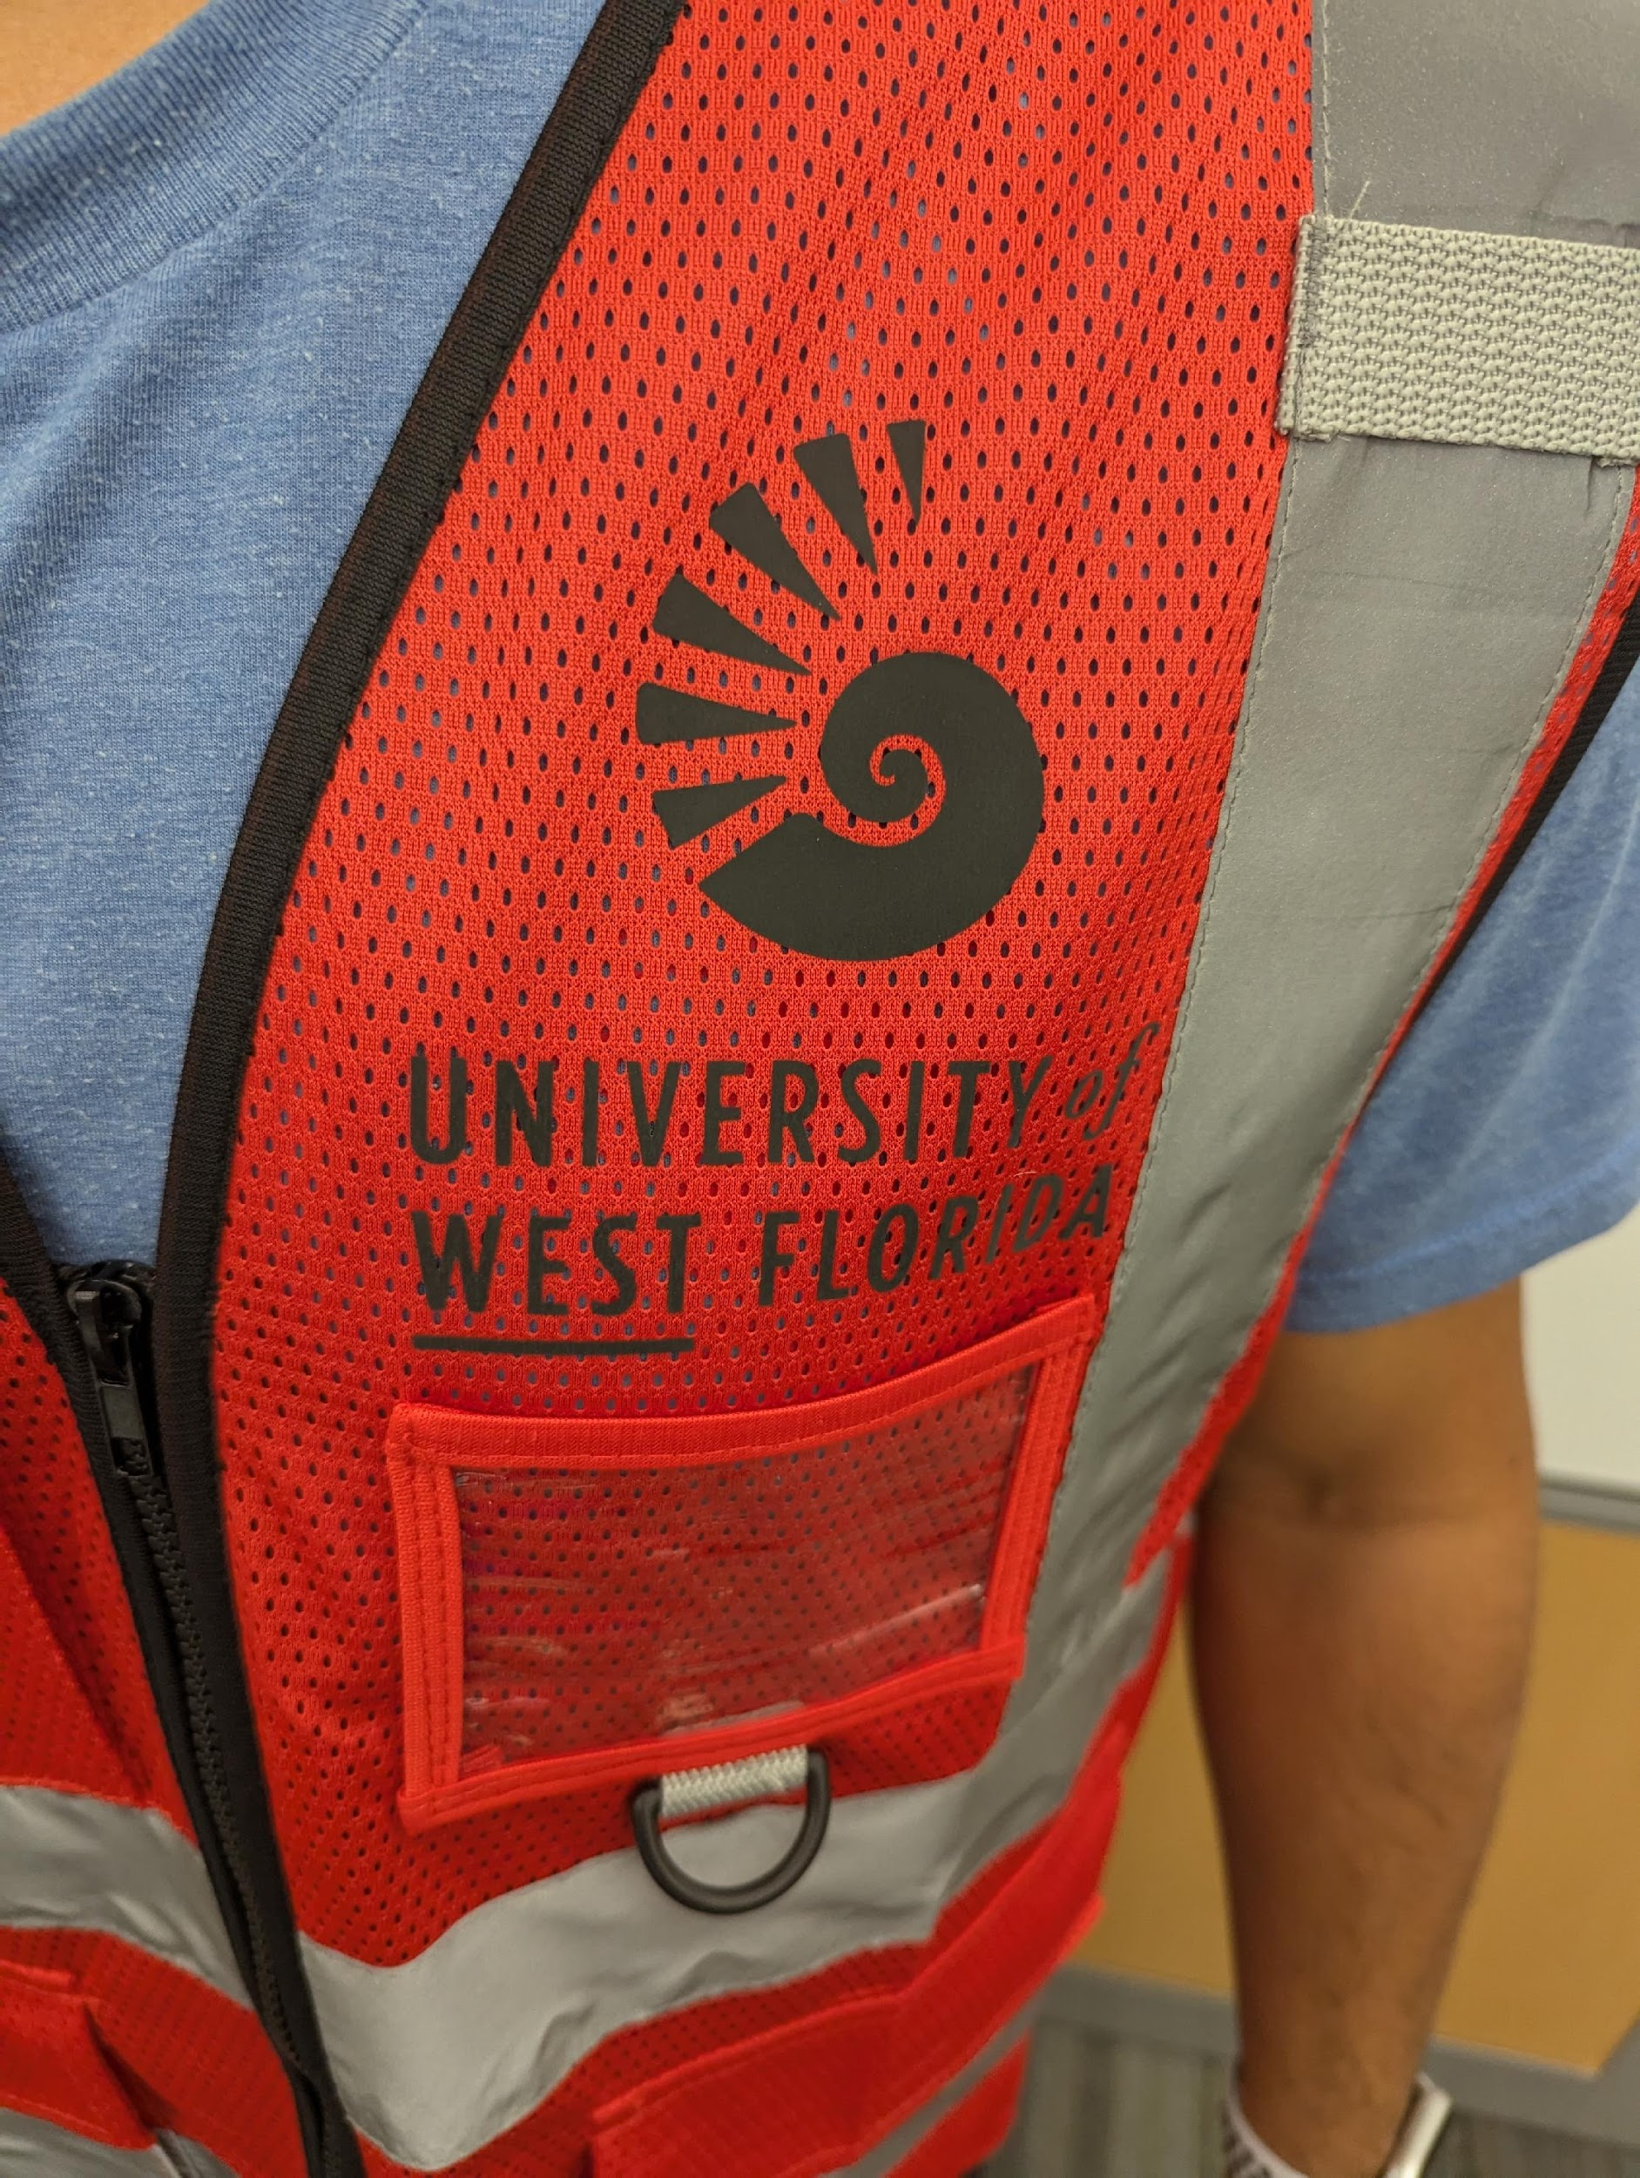
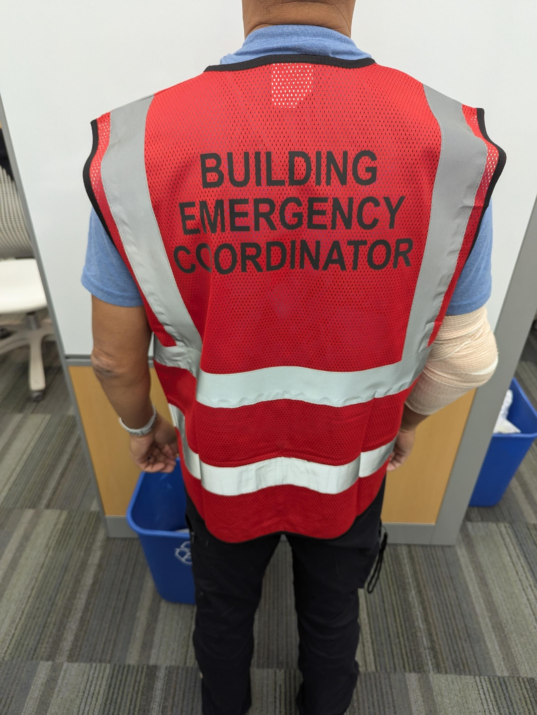
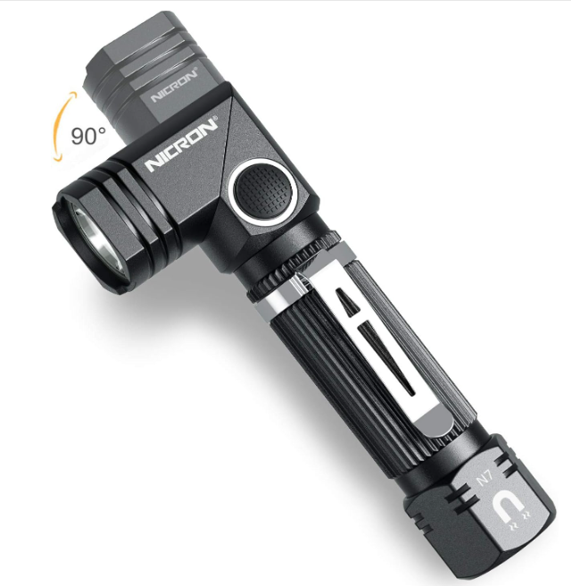
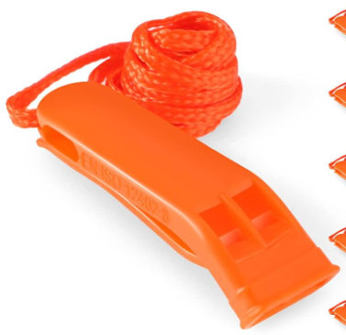

Equipment
Safety Vest
Flashlight
Safety Whistle
Clipboard

Slide 9
B.E.C. Activities
Building Information
Building Threats
Basic Emergency Procedures
Facilities Liaison
Emergency Services Liaison
Assist with UWF Closures
Assist with Damage Assessment
B.E.C. Email distribution
Other Duties as Assigned by UWF Officials

Slide 10
Building Information
B.E.C.’s should be knowledgeable of the following:
  Be knowledgeable of departmental space in building (critical issues, special circumstances, hazards, etc.)
  Maintain contact information for restricted areas
  Serve as conduit for emergency/preparedness information
  Update appropriate emergency supplies such as hurricane closure materials
  Coordinate with other B.E.C.’s in your building including those from other departments/colleges
  Know your evacuation procedures and rally points

Slide 11
Building Threats
Bomb Threats
  Suspicious objects or packages
  Receiving a threatening communication
Fire
  Building evacuation/rally point location(s)
  Fire Alarm Procedures
Shelter in Place
  Secure building
Active Assailant

Slide 12
Emergency Procedures
^{Fire}
^{If you observe smoke or fire:}
Activate the fire alarm using a manual pull station.
EVACUATE the building and notify others as you exit.
^{Do not use elevators.}
Notify Emergency Personnel of persons with disabilities who are unable to evacuate.
As you exit, move to a safe distance. Do not re-enter until notified by emergency personnel.
^{Active Assailant}
If a person enters the building with a weapon, if you hear gun fire or observe suspicious behavior, evacuate the building and move to a safe location if it is possible to do so.
Once you have evacuated the building, contact the UWF Police (850.474.2415) and provide as much information as possible.
If evacuation is not possible, find a secure area to hide until notified it is safe to leave by emergency personnel.
As a last resort, if confronted by the violent person you should attempt to incapacitate or disrupt the individual.
^{Medical Emergency}
Contact the UWF Police (850.474.2415), provide information on the type of injury and the campus location of the victim.
Provide first aid or medical assistance if required.
Remain with the injured individual until help arrives.
If the injured person is unconscious and not breathing start CPR, if trained to do so.
^{Shelter-in-Place}
During an event of severe weather or tornado warning:
The University will activate appropriate methods of emergency notification.
Immediately seek refuge inside the nearest building.
Find a safe location in the lowest level, preferably in interior hallways or rooms away from glass windows.
Remain in safe location until instructed by UWF authorities it is safe to leave the building.
Power Outage or Utility Failure
Contact Facilities Management, Work Order Control Center (850.857.6000) to report a utility failure.
If there is a possible danger to building occupants, exit the building and call the UWF Police (850.474.2415).
Notify emergency personnel of persons with disabilities who are in the building and if there are any individuals trapped in an elevator.
The UWF administration will decide on the status of classes based on the situation.
^{Hazardous Materials}
If a chemical spill occurs within a campus building, immediately notify the UWF Police (850.474.2415).
If a chemical spill occurs outside of a building or from an off-campus source, follow instructions given by UWF officials.
In either case, notify the UWF Police (850.474.2415) if you have been exposed to a chemical.
The University will provide instructions through the University’s Emergency Notification System.
^{Bomb Threat}
If you receive communications that an explosive device may be on campus:
Get as much information from the caller as possible.
Call the UWF Police (850.474.2415).
If told to evacuate by UWF Police, do so and move away from the building. Do not touch anything!
^{Suspicious Package}
If you observe a suspicious object, which may be a potential bomb, DO NOT HANDLE THE OBJECT.
Contact the UWF Police (850.474.2415). Provide as much information as possible.
Evacuate the area and await instructions from the UWF Police.

Slide 13
Medical Emergencies!!!
Call 9-1-1
Get the A.E.D.
(Automated External Defibrillator)
https://uwf.edu/finance-and-administration/departments/environmental-health-and-safety/automatic-external-defibrillators/about-automatic-external-defibrillators-aeds/

Slide 14
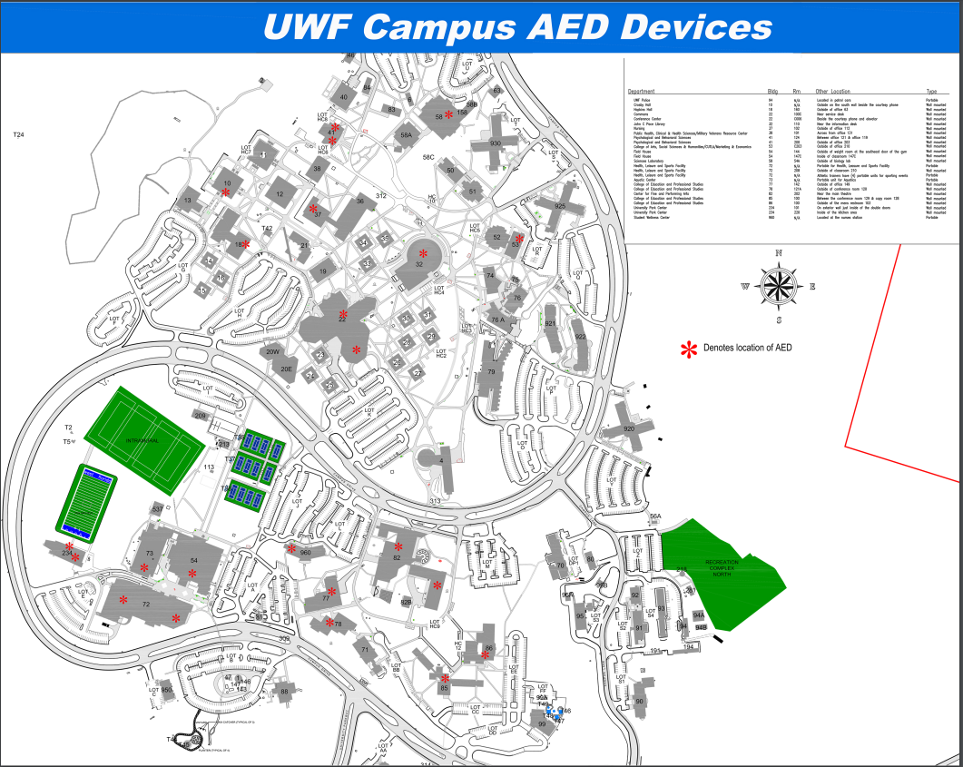
A.E.D. Locations

Slide 15
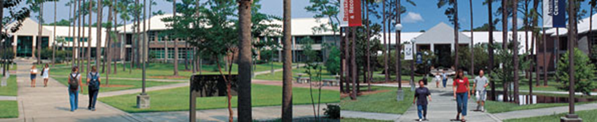
Facilities Liaison
Provides a point person for Facilities
Provides information to building occupants
Notify Facilities of building issues
  Call Work Order Control Center at Ext. 6000

Slide 16
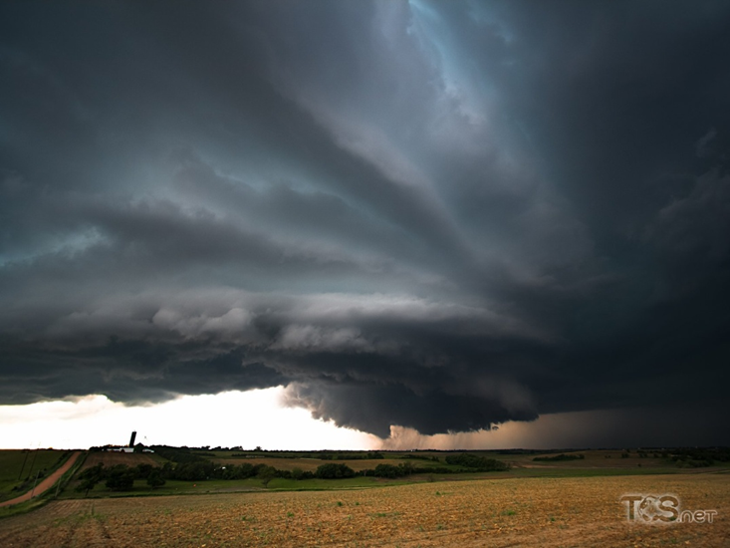
Severe Weather – General Information and Weather Monitoring
Resources for monitoring severe weather:
  National Weather Service (NWS), Mobile, AL:
  https://www.weather.gov/mob
    Issues Watches and Warning for area
Understand weather watches and warnings
  Watch means hazardous weather is possible.
  Warning is issued when hazardous weather is occurring, and poses a risk to
  life or property.

Slide 17
Tropical Weather and Hurricanes
UWF follows forecasts issued by the National Hurricane Center – https://www.nhc.noaa.gov/
B.E.C.’s should monitor tropical weather information throughout hurricane season (June 1 - November 30)
The Emergency Management Department will send any pertinent weather updates for dissemination to your building

Slide 18
UWF Closures-Weather Related
UWF closure decision made by UWF President or designee
UWF closure is really a suspension of normal activities. UWFPD, Facilities, etc. continue to operate
Shelters
  B72 (HLS Building)

Slide 19
UWF Closures – B.E.C. Activities
Ensure completion of closure checklist(s) –
  Office closure checklist
  Lab/research area checklist
Secure vehicles inside a structure, if possible
Monitor information from UWF Emergency Management and UWF Administration regarding operational schedules

Slide 20
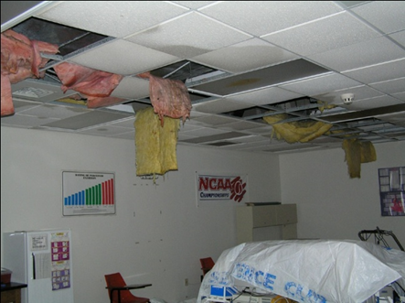
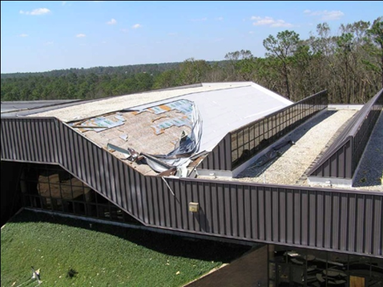
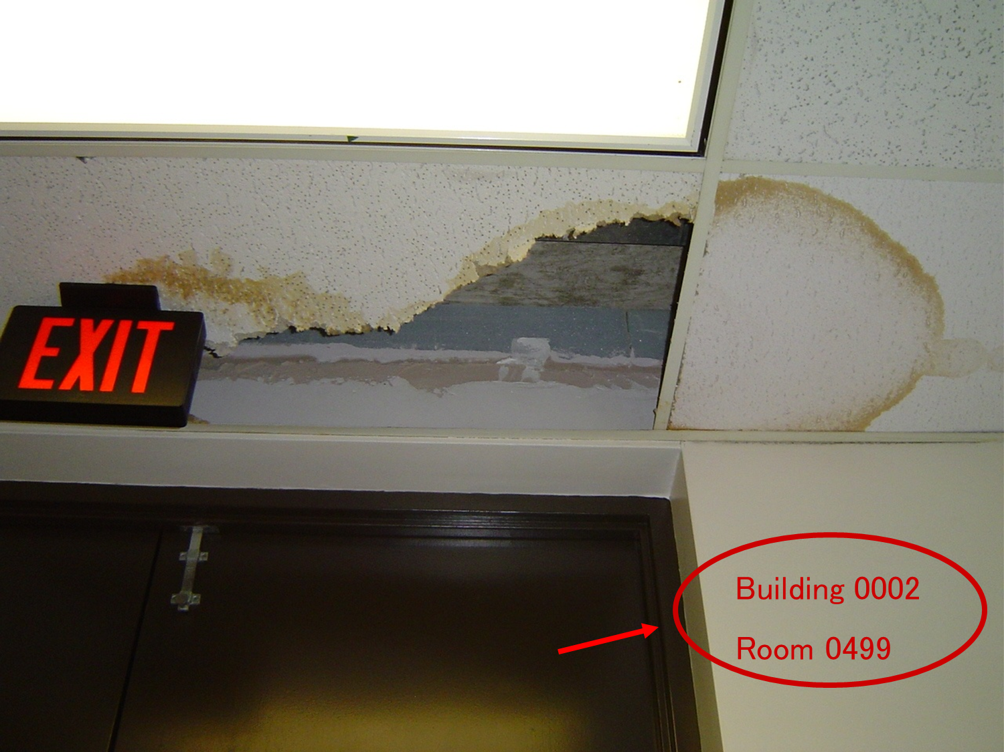
Damage Assessment
Only when needed and/or specifically requested after a severe weather event.
Assist Facilities Management with assessment of your building.
Take pictures of damage and include building & room number in image.
Directly contact Work Control, Ext. 6000, for urgent or critical items.

Slide 21
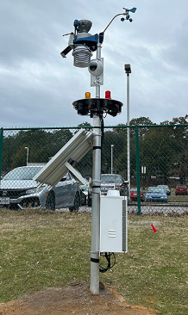
UWF Emergency Notification
Important UWF Emergency Communications
Multimodal approach to campus-wide notification:
  Text Messaging
  Email
  X (Formerly Twitter)
  Facebook
  Sirens
  Lightning Prediction System
  UWF Homepage & WUWF radio (official source for information)
Argo Alert notification speakers installed in numerous campus building.
Important for B.E.C.’s to provide your current emergency contact information to Emergency Management as soon as possible.

Slide 22
Fire Extinguisher Types
Class A – Fires in ordinary combustible materials, such as wood, cloth, paper, rubber, and many plastics.
Class B – Fires in flammable liquids, combustible liquids, petroleum greases, tars, oils, oil-based paints, solvents, lacquers, alcohols, and flammable gases.
Class C – Fires that involve energized electrical equipment.
Class D – Fires in combustible metals, such as magnesium, titanium, zirconium, sodium, lithium, and potassium.
Class K – Fires in cooking appliances that involve combustible cooking media (vegetable or animal oils and fats.)

Slide 23
Fire Extinguisher Training
P.A.S.S.
Pull – Pull the pin!
Aim – Aim at the base of the fire
Squeeze – Squeeze the handle
Sweep – Sweep from side to side
You should only use a fire extinguisher on small fires and if safe to do so

Slide 24
Rally Points
Organize the building occupants around the designated rally point(s)
Take roll call (accountability) the best that you can
Consider environmental elements at rally points and relocate evacuees, if needed (wind, rain, heat, smoke, etc.)
Follow instructions given by Public Safety officials, UWF officials, and other emergency personnel

Slide 25
Document, Document, Document…
Document the following…
EVERYTHING!

Slide 26
Continuing Education/Training
Live Fire Extinguisher Training
Basic First-Aid
Stop-The-Bleed
Building Searches
UWF Campus C.E.R.T.

Slide 27
Cadence of Training
Annual – each B.E.C. will be asked to attend an in-person training/meeting or SCOOP assigned training

Slide 28

Questions?
Emergency Management Department
Chris Hinnant, Interim Director
Building 94
Ext. 3274
chinnant@uwf.edu
UWF Police Department
David Faircloth, Captain
Building 94
Ext. 2415
dfairclo@uwf.edu

