Slide 1
Typography of Titles in Turabian
John David Brown
Capstone
Spring 2014
Source: A Manual for Writers of Research Papers, Theses, and Dissertations, Seventh Edition: Chicago Style for Students and Researchers

Slide 2
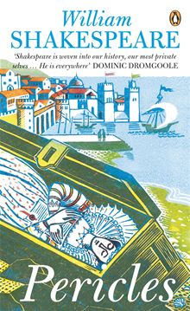
Italicize
Books: Devil in the White City
Plays: Pericles
Book-length poems: Dante’s Inferno
Journals: Past and Present
Magazines: Newsweek
Newspapers: Wall Street Journal

Slide 3
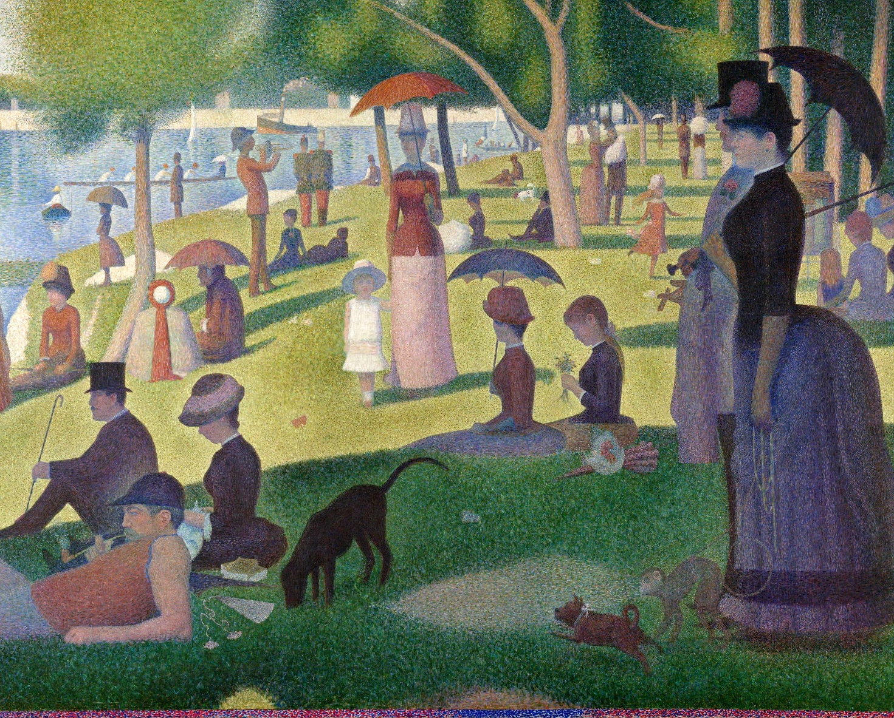
Italicize
Long musical compositions: Marriage of Figaro
Works of art (except photographs): Sunday Afternoon on the Island of La Grande Jatte
Movies: Raiders of the Lost Ark
Television series: Myth Busters
Radio Programs: All Things Considered

Slide 4
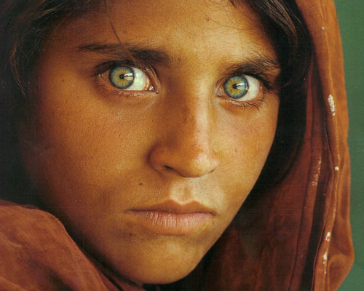
Use “Quotation Marks”
Chapters: “In the White City”
Short stories: “A Mother”
Short poems: “Fire and Ice”
Essays: “Self-Reliance”
Articles: “Puritans and the Poor”
Individual TV episodes: “Jet-Assisted Chevy”
Short musical compositions: “America the Beautiful”
Photographs: “Afghan Girl”

Slide 5
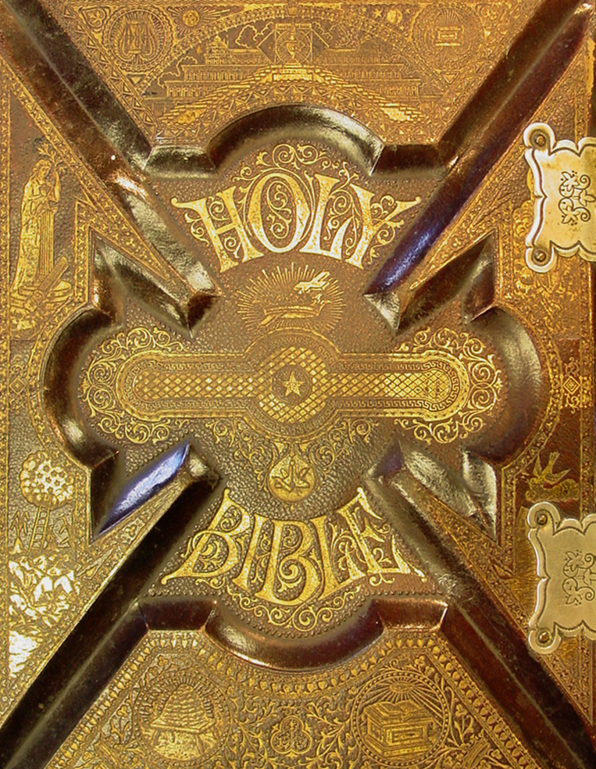
No Special Typography
Book series: the Saxon Stories
Manuscript collections: Egmont Manuscripts
Scriptures or ancient religious texts: the Bible
Musical works referred to by genre: Symphony no. 5
Web sites: Drudgereport.com
Note—In citations, web sites should be italicized and web pages should be put in quotation marks.

