Slide 1
Who are the Jews of China and Japan?

Slide 2
Jews are Global, not only Western
Jewish history does not begin and end with Europe.
It is also Asian, both in origin and destiny.

Slide 3
C h i n a
There is evidence of Jewish presence in China since the 9th century, under the “Sung” dynasty.
Marco Polo (1200s) mentions prosperous Jewish merchants in China on the coastal cities.
Their numbers were small, unlike the case in India.
The best known were the so-called “Kaifung Jews” in Northeast China.

Slide 4
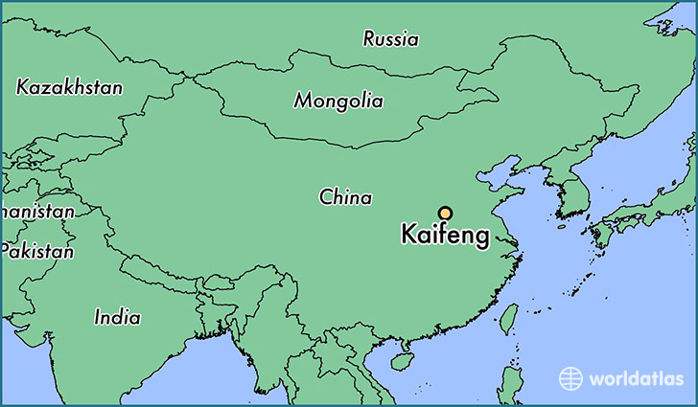
Kaifeng Jews of NE China.

Slide 5
The Kaifeng Jews of China
A small Jewish community in NE China.
Over the long stretches of time, their numbers declined thru marriage with the Han Chinese.
Important point: Jews were not persecuted in China, unlike the case both under Christianity and under Islam.
Jews in China, even tho small in number, rose to high status both in business and in some cases in government.

Slide 6
Prof Xu Xin:
Kaifeng Jews developed a distinctive culture that was unquestionably Jewish, but progressively Chinese.
Their greatest problem was not separation from other Jews, but the openness of Chinese society.
Intermarriages occurred often.
Over time, they were so completely assimilated that few of their descendants carry any memory of Jewish ancestry.
They look much like other Chinese. “The story of the Kaifeng Jews is dramatic and colorful.”
.

Slide 7
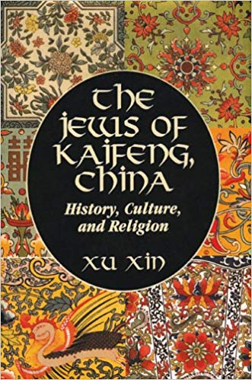
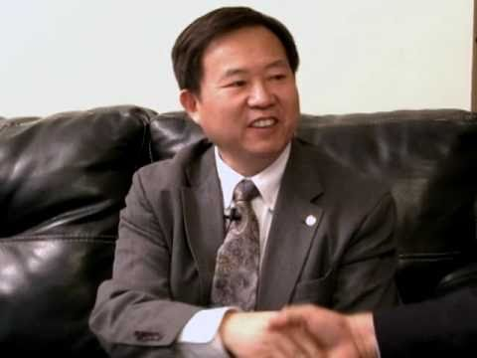
Prof Xu Xin

Slide 8
In 1860, a flood destroyed the small synagogue in Kaifung.
This led to the community's demise.
A recent census showed only about 500 descendants of Kaifeng Jews.
The Chinese communist govt is opposed to religious revival.

Slide 9
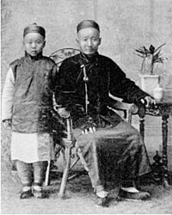
An image of Kaifeng Jews

Slide 10
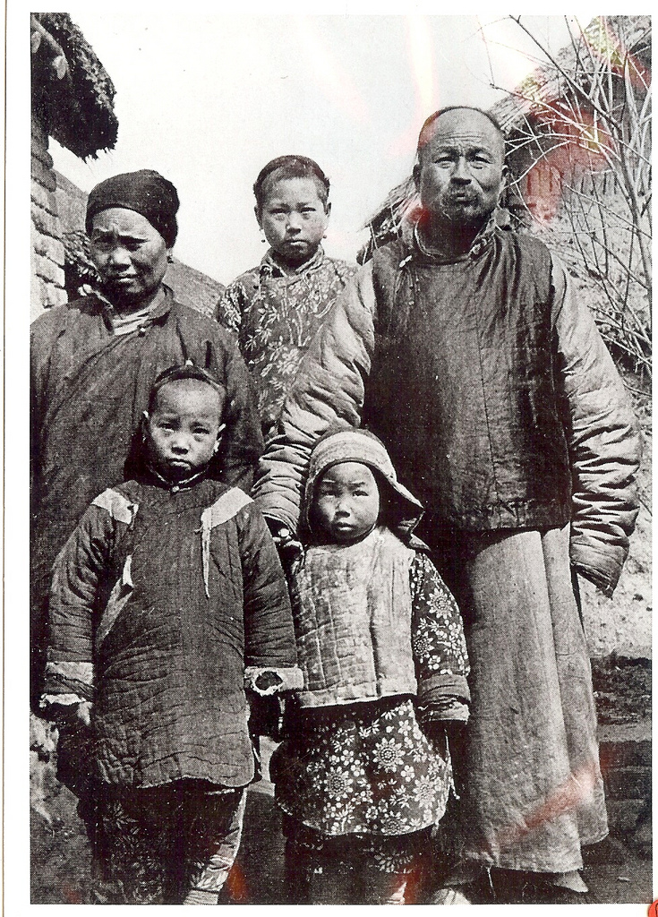

Slide 11
Prof Daniel Elazar
There is a lot of American interest about Chinese Jews.
To fill their need, history is being re-created. The number of Chinese Jews will certainly grow.
This will cater to American and Israeli tourists.

Slide 12
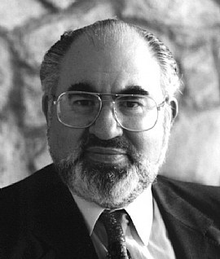
Prof Daniel Elazar (1934-99)
Jerusalem Center for Public Affairs, and of Temple University, Philadelphia.

Slide 13
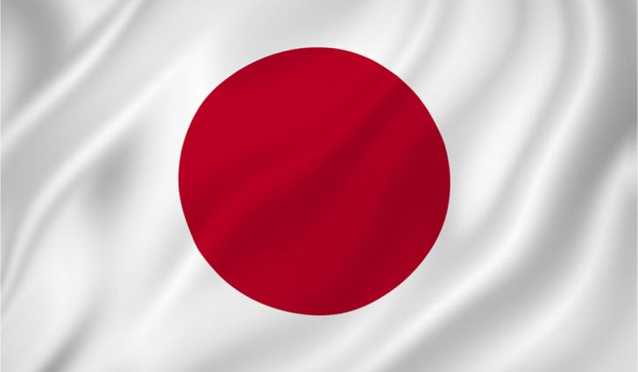
Let us now turn to Japan: the Land of the Rising Sun

Slide 14
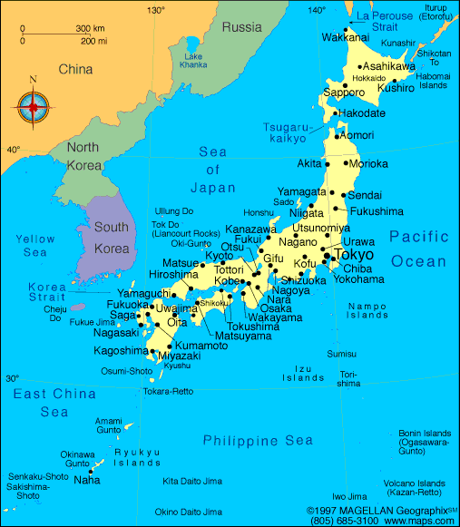

Slide 15
Japan
There is no native Jewish population in Japan, unlike in India and to a smaller extent in China.
But Japan played an important role in saving Jews during the WW11 holocaust.

Slide 16
Jews of Japan
Like China, there is much interest in Jews of Japan.
In 1800s, Rev McCloud, a Christian missionary, opined that the Japanese were one of the Lost Tribes of Israel.
Why? Because , like the Jews, the Japanese were creative, ingenious, and smart.

Slide 17
Story of Mr. Sugihara who saved 6,000 Jewish lives
Sugihara was the Japanese vice-Consul in Lithuania, a neutral country in WWII.
During the War, Jews were fleeing Poland and Germany.
Sugihara issued MANY entry visas to Japan to the fleeing Jews.
Remember that Japan was an ally of Germany. But Sugihara ignored his orders and issued visas to fleeing European Jews.

Slide 18
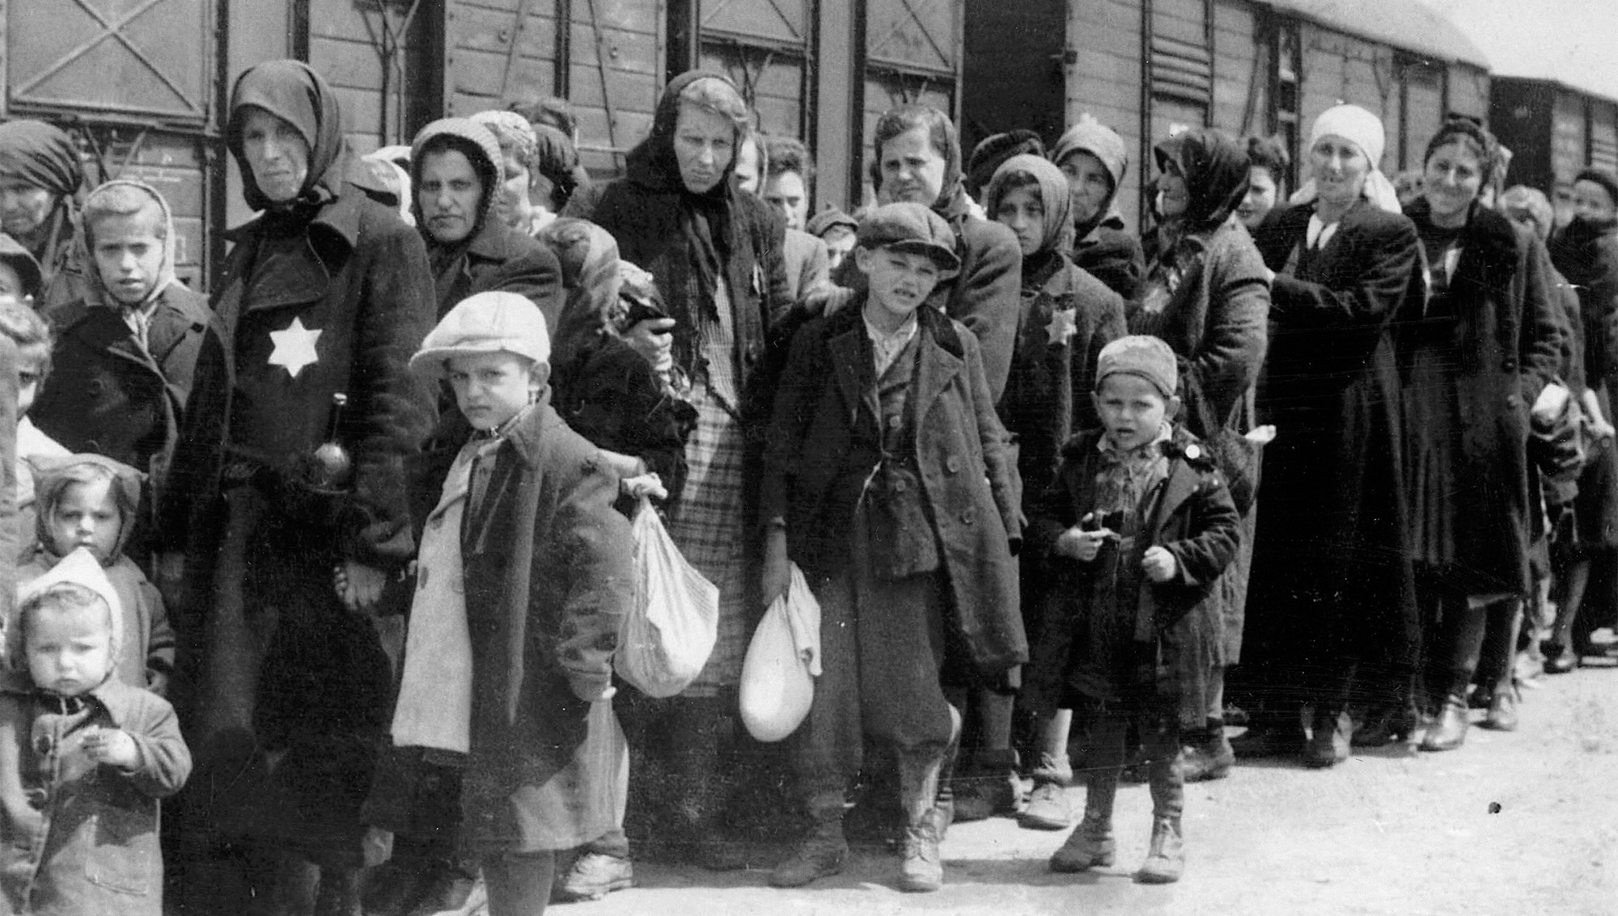
European Jews

Slide 19
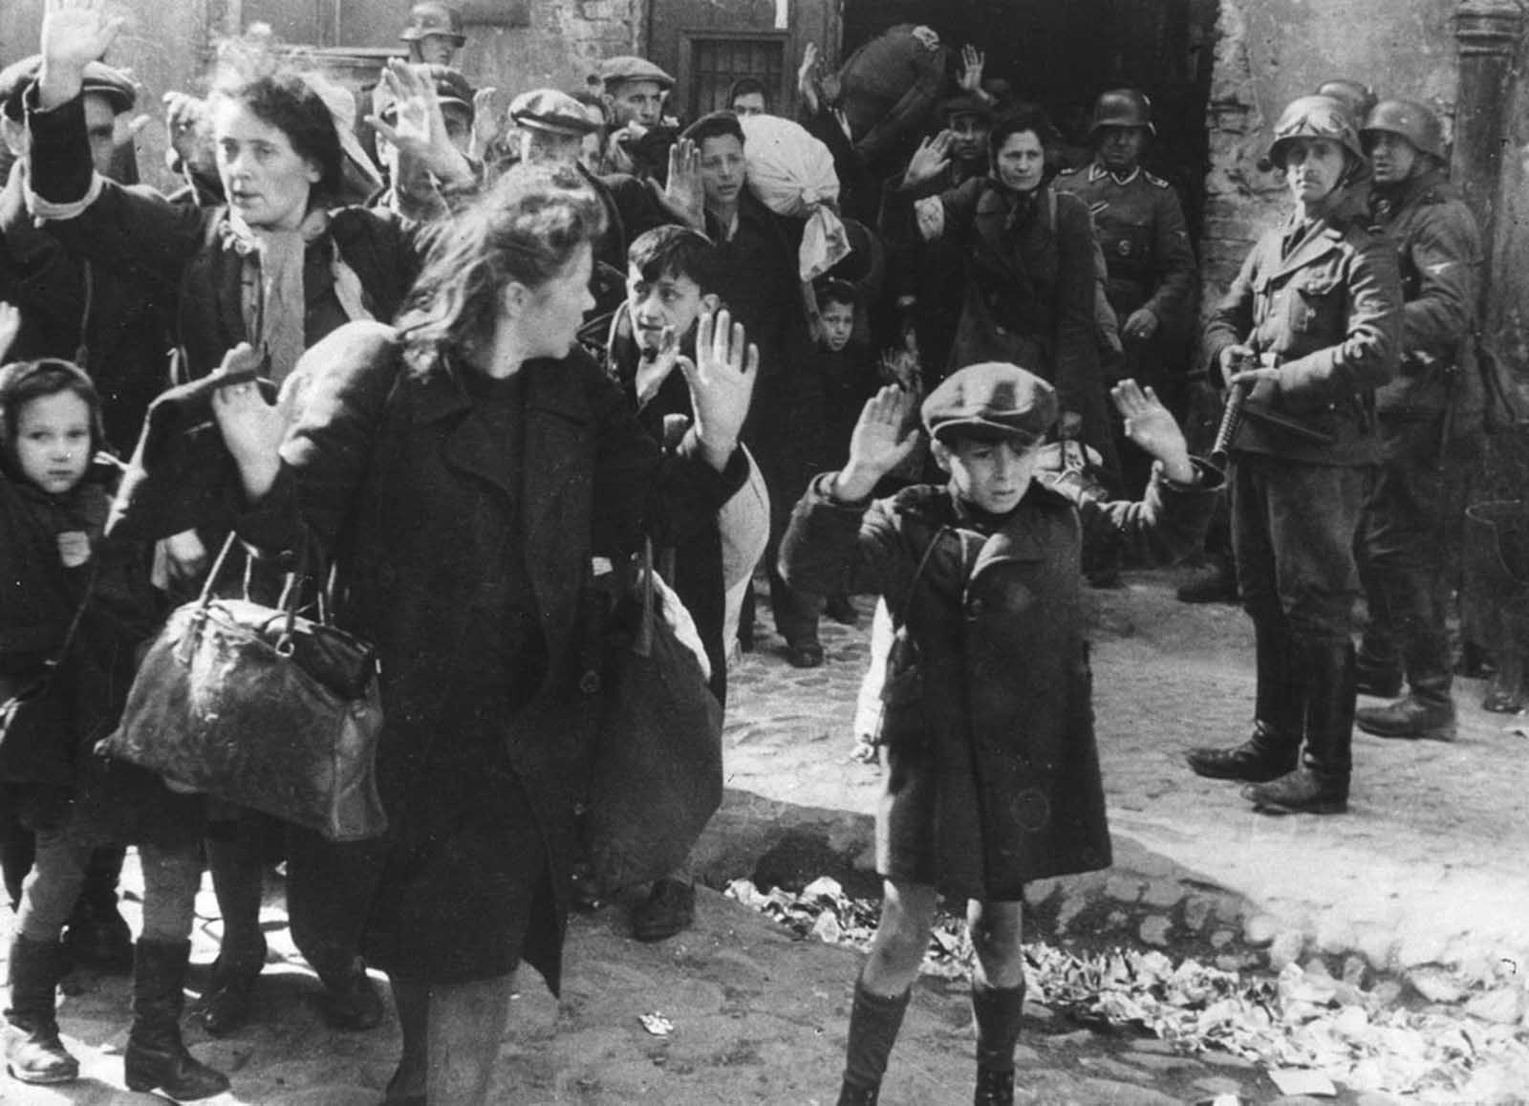
European Jews

Slide 20
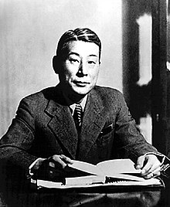
Chiune Sugihara, 1900-1986
Israel honored him as one of the Righteous Among the Nations (Hebrew: חסידי אומות העולם).

Slide 21
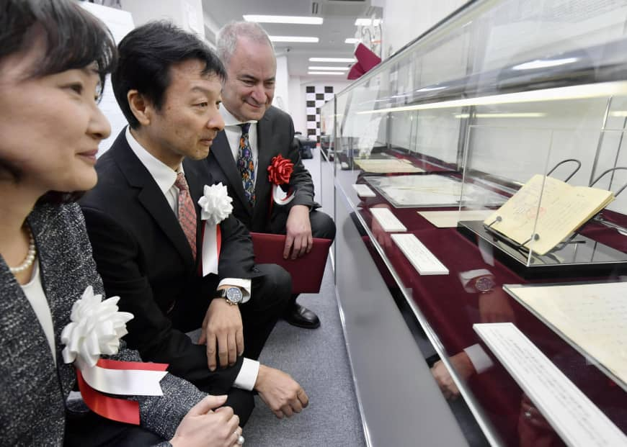
Sugihara Museum in Gifu near Tokyo

Slide 22
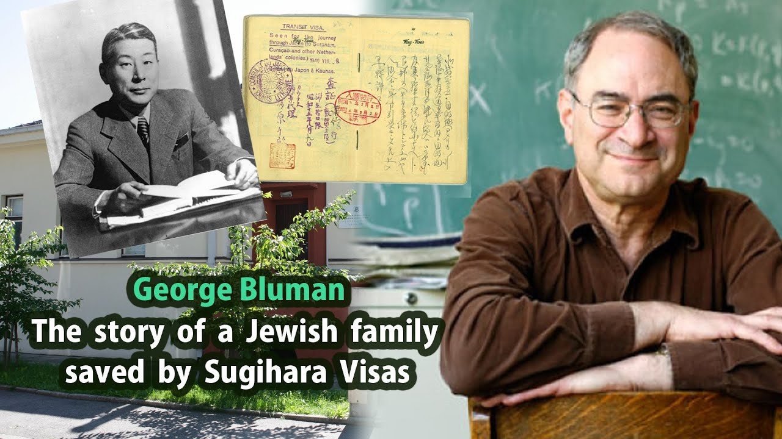

Slide 23
Dr. George Bluman, professor in Canada, has written an impassioned book on Sugihara.
“Persona non-Grata” is a short film on Sugihara life. Check the web.
Dr. Bluman: 200,000 descendants of the people saved by Sugihara, among these Dr. Bluman, himself.

Slide 24
The story of Shanghai port in NE China.
See map for location.

Slide 25
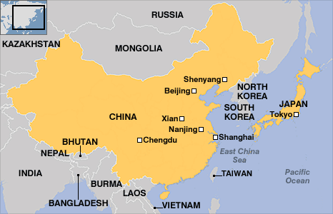
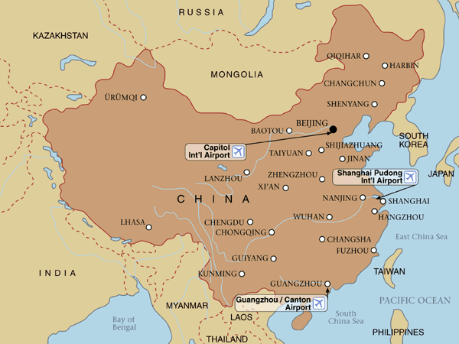
18,000 Jews of Shanghai

Slide 26
18,000 Jews of Shanghai
Shanghai was under Japanese control during the War.
Shanghai was one of the few places in the world where one didn't need a visa.
Many European Jews took advantage of the open city and traveled on land or sea with much hardship.
The Germans pressured the Japanese allies to expel or to exterminate the Jews. The Japanese ignored the orders.
Most of these Jews later migrated to Israel, Canada and the US.
Among these was Michael Blumenthal: the US secretary of the Treasury.

Slide 27
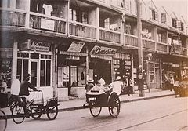
Shanghai ghetto, 1943

Slide 28
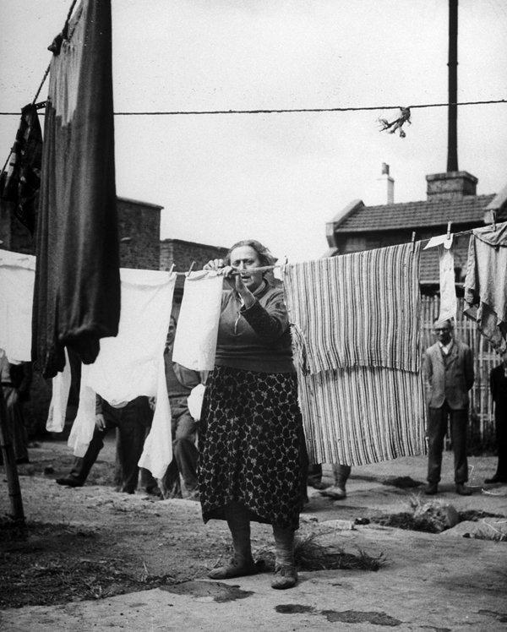
A Jewish refugee in Shanghai

Slide 29
Werner Michael Blumenthal,1926-
He was a German-born American business leader, economist and political adviser. He served as the Treasury Secretary of the United States under President Jimmy Carter from 1977-1979.
At age thirteen, Blumenthal barely escaped Nazi Germany with his Jewish family in 1939. He was forced to spend World War II living in the enclave of Shanghai in China, then under Japanese control.
Blumental also served as the director of the restored Jewish Museum in Berlin. He is the author of From Exile to Washington (2013).

Slide 30
Exhibit in Brooklyn, NY, 2019
A small but important trail of refugees fleeing the Nazis took an unusual detour through China.
A new exhibit in Brooklyn marks the journey.

Slide 31

Baltimore exhibit, 2019

Slide 32
Thanks for watching.
uwf.edu/lgoel

