Slide 1



Fall Faculty Forum 2025
Jaromy Kuhl, Senior Vice President and Provost

Slide 2
Looking Back…

Slide 3
Tenure and Promotion Recipients
COLLEGE OF ARTS, SOCIAL SCIENCES AND HUMANITIES
Tenure and Promotion to Associate Professor
Jennifer Brinkley
Chrystina Hoffman

Slide 4
Tenure and Promotion Recipients
COLLEGE OF ARTS, SOCIAL SCIENCES AND HUMANITIES
Promotion to Senior Instructor/Lecturer
Claire Holderman
Corey McKern
Jasara Norton
Gina Sakalarious-Rogers
Scott Satterwhite
Kwimi Taylor

Slide 5
Tenure and Promotion Recipients
COLLEGE OF ARTS, SOCIAL SCIENCES AND HUMANITIES
Promotion to Senior Research Associate
April Holmes
Jennifer Melcher
Mike Thomin

Slide 6
Tenure and Promotion Recipients
HAL MARCUS COLLEGE OF SCIENCE AND ENGINEERING
Promotion to Professor
Nye Grant

Slide 7
Tenure and Promotion Recipients
HAL MARCUS COLLEGE OF SCIENCE AND ENGINEERING
Tenure and Promotion to Associate Professor
Mahd Alzoubi
Lisa Waidner
Tenure
Mengying Xiao

Slide 8
Tenure and Promotion Recipients
HAL MARCUS COLLEGE OF SCIENCE AND ENGINEERING
Promotion to Senior Lecturer
Tony Al-Abed, Karen Barnes, Kari Clifton, Tom Gilbar, Chasidy Hobbs, Shawn Kim, Jeff McGuirk, Meagan McNamee, Bradley McQuaig, Anthony Pinto, Karen Pritchard, Lauren Rex, Katie Whitaker, Aletheia Zambesi

Slide 9
Tenure and Promotion Recipients
LEWIS BEAR JR. COLLEGE OF BUSINESS
Promotion to Professor
Barbara White

Slide 10
Tenure and Promotion Recipients
LEWIS BEAR JR. COLLEGE OF BUSINESS
Tenure and Promotion to Associate Professor
Gerald Burch
Lauren Rich

Slide 11
Tenure and Promotion Recipients
LEWIS BEAR JR. COLLEGE OF BUSINESS
Promotion to Senior Instructor
Helen Soter

Slide 12
Tenure and Promotion Recipients
SCHOOL OF EDUCATION
Tenure and Promotion to Associate Professor
Holley Handley

Slide 13
Tenure and Promotion Recipients
SCHOOL OF EDUCATION
Promotion to Senior Instructor
Melanie DiLoreto
Karen Evans
Amany Habib

Slide 14
Tenure and Promotion Recipients
USHA KUNDU, MD COLLEGE OF HEALTH
Promotion to Professor
Melinda Lewis

Slide 15
Tenure and Promotion Recipients
USHA KUNDU, MD COLLEGE OF HEALTH
Tenure and Promotion to Associate Professor
Erin King
Lauren Ricciardelli

Slide 16
Tenure and Promotion Recipients
USHA KUNDU, MD COLLEGE OF HEALTH
Promotion to Associate Professor of Clinical Practice
Kathleen Andresen
Mariah Morris
Andrea Nelson
Cynthia Smith-Peters

Slide 17
Tenure and Promotion Recipients
USHA KUNDU, MD COLLEGE OF HEALTH
Promotion to Senior Instructor/Lecturer
Patsy Barrington
Jake Bush
Katie Cavnar
Kristen Coffey
Amy Crawley
Chris Dake
Wesley Farr

Slide 18
Tenure and Promotion Recipients
JOHN C. PACE LIBRARY
Promotion to Librarian
Liza Campbell

Slide 19
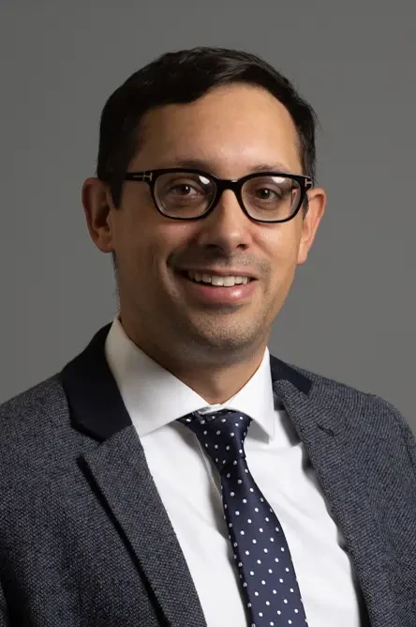
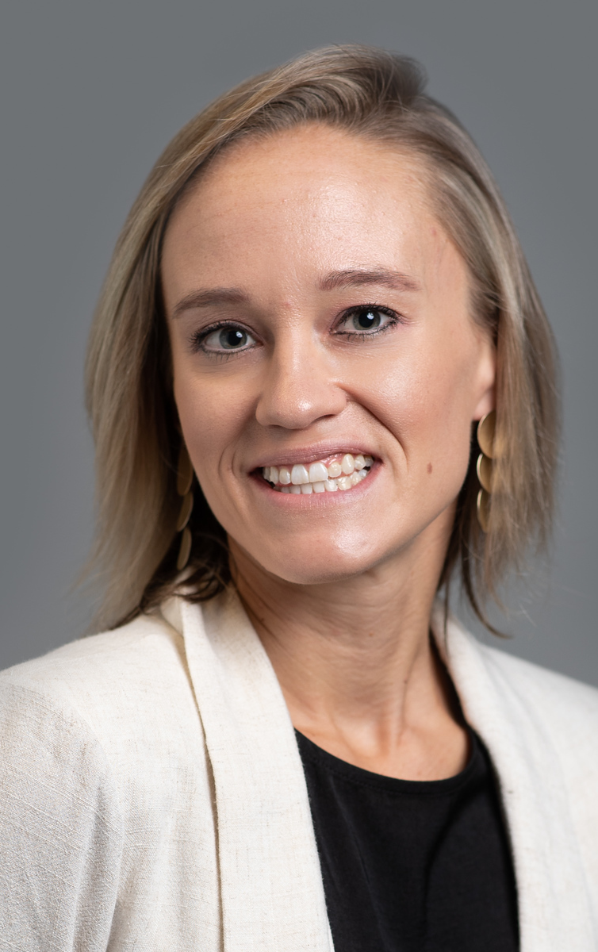
Leadership Announcements
Jacob Shively
CASSH
Associate Dean
Maggie Davis
LBJCOB
Associate Dean

Slide 20
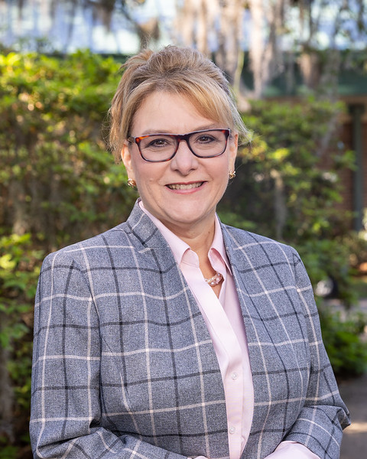
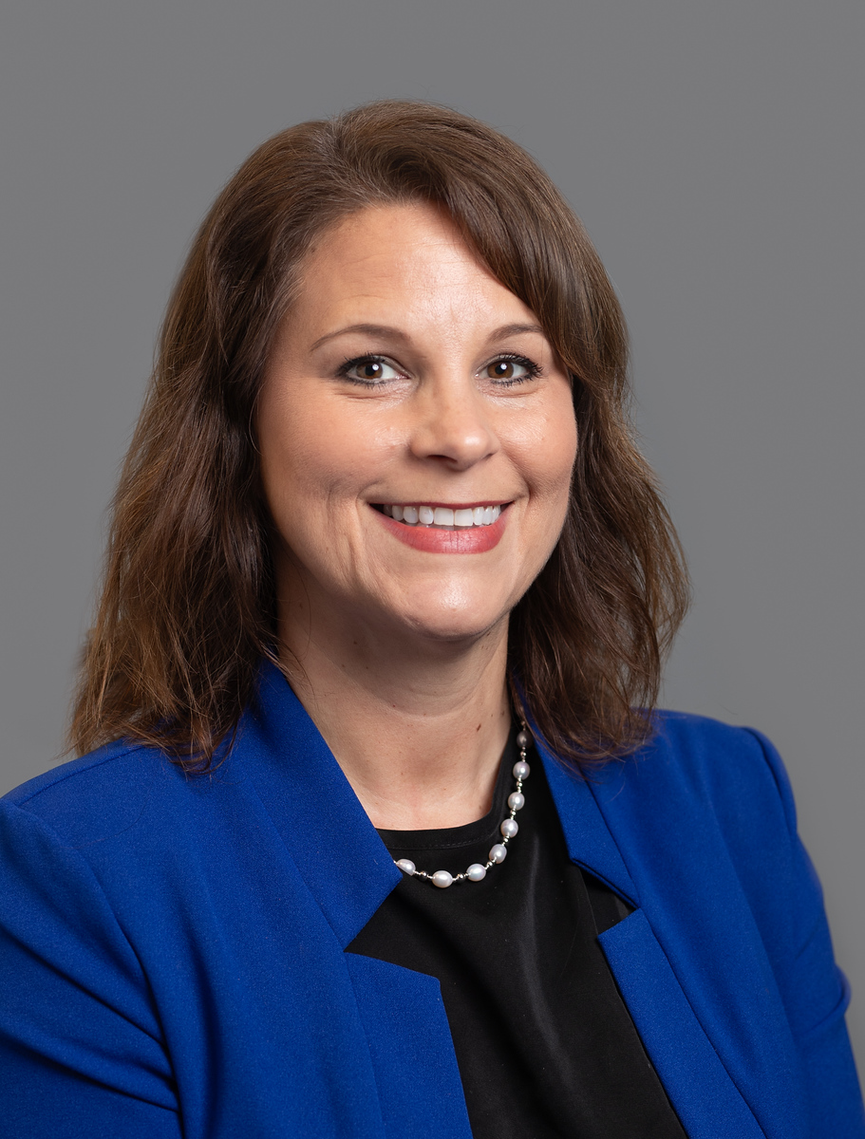
Leadership Announcements
Denise Soares
SOE
Dean
Melissa Webb
SOE
Assistant Dean

Slide 21
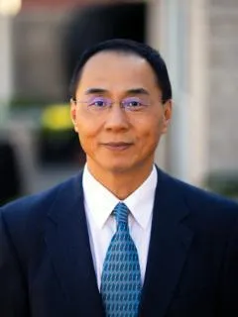
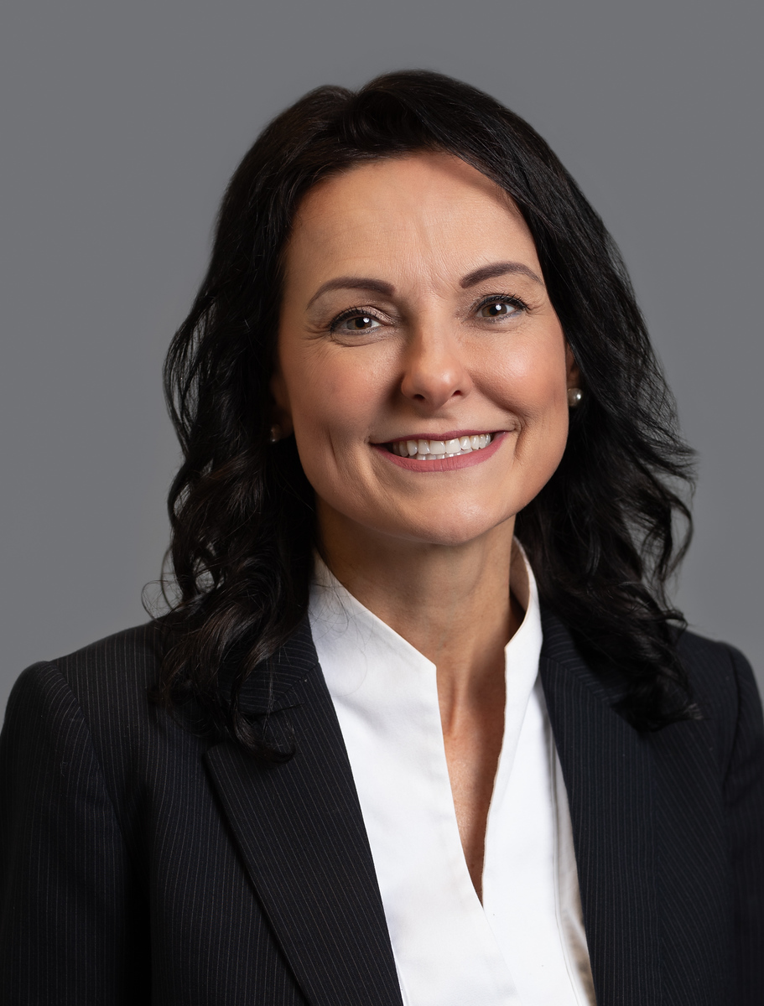
Leadership Announcements
Jerry Lin
RAE
Associate Vice President
Shelley Diviney
UKCOH
Interim Dean

Slide 22
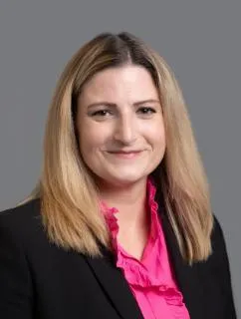
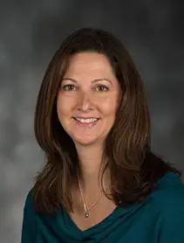
Leadership Announcements
Heather Riddell
Faculty Senate
President
Amy Mitchell-Cook
Faculty Senate
Vice President

Slide 23
Organizational Changes
Graduate School is now the Office of Graduate Studies
Graduate Admissions has moved to Enrollment Affairs
Kugelman Honors Program moved to Academic Affairs
First Year Advising, Tutoring and Learning Resources and TRIO moved to Academic Affairs

Slide 24
RAFFLE!

Slide 25
Looking Forward…

Slide 26
CASSH
Launching the Gulf Coast Culture series
Launching new programs:
  AI in the Workplace Certificate (Undergraduate & Graduate)
  Spanish Language and Culture Certificate (U)
  Graphic Design and Digital Media, B.F.A.
  Civic Literacy Certificate (U & G)
  Criminal Justice Leadership Certificate (G)
  Pre-Art Therapy, B.A.
  Graphic Design and Digital Media, Illustration, B.F.A.
  History ABM

Slide 27
HMCSE
Completed a $1.5 Million renovation of Building 80
Completed remodeling research labs in Building 58 totaling $1.8 Million.
Launching new programs:
  Civil Engineering, B.S.
  AI Cybersecurity Certificate

Slide 28
LBJCOB
Over the past academic year, enrollment grew by:
  17% in the Master of Accountancy (MAcc) program
  10% in the MBA program
  6% in the BSBA in Supply Chain Logistics Management (SCLM) program
The MAcc program was ranked #79 in U.S. News & World Report’s Best Online Master’s in Business Programs
The MBA program earned a #93 ranking in Best Online MBA Programs for Veterans
The BSBA in SCLM was recognized as a top 10 best overall online bachelor’s program and a top 20 most affordable program

Slide 29
SOE
Achieved #20 in Best Online Master's in Education Programs for Veterans
Teacher Ready opened at UWF during the 24-25 Academic Year and admitted 756 students
Graduated 39 Ed.D. students during the 24-25 Academic Year
Climbed from #100 to #63 in U.S. News & World Report’s Best Online Master’s in Education Programs

Slide 30
UKCOH
Held a Behavioral Health Colloquium featuring a 6-part lecture series
Launched student peer mentoring programs to build belongingness and increase retention.
Redesigned the Healthcare Simulation Center in Building 37.

Slide 31

2025-2026 LEAD Class
Lauren Adolf
Darby Drapeau
Kate Durden
Kaley Ellison
Christian Garman
M.A. Karim
Meghan Kochevar
Twana McDaniel
Jade McNeil
Lori Milkeris
Lexi Miller
Emma Miller
Keyaundra Mobley
Regina Murphy
Mudasir Mustafa
Carla Scott
Karen Tibbals

Slide 32

2025-2026 LEAD2 Class
Chip Chism
Susan Drahos
Ali Green
Kathrine Johnson
Aurora Osborn
Christian Pacheco
Megan Veach

Slide 33
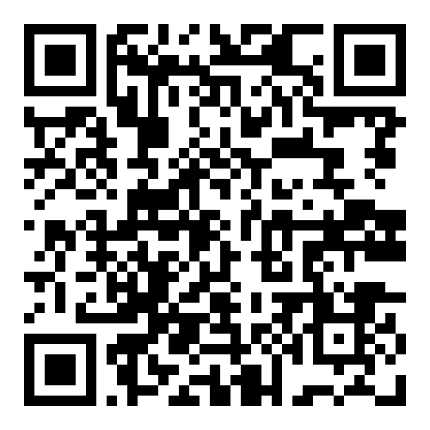
NextGen Provost Fellows Program
We invite applications from full-time faculty who are:
Interested in advancing their leadership skills in areas such as academic innovation, student success, and strategic planning.
Eager to collaborate across departments and contribute to institutional priorities.
When: October 2025 - April 2026
Applications are due by August 24, 2025.
Application:

Slide 34
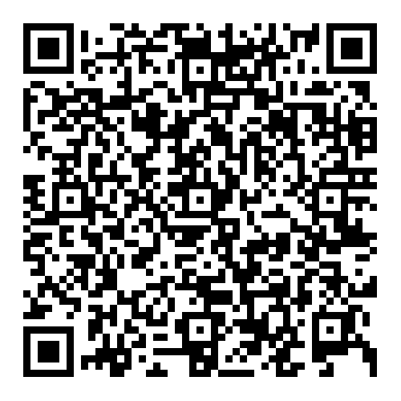
Faculty Awards Celebration
Applications are open and due Wednesday, September 3 for the following awards:
Excellence in Teaching
Distinguished Service
Distinction in Scholarly, Creative and Research Activities
Excellence in Undergraduate Research Mentoring
A new award for Community Engagement
The event will take place on November 20th at 2 p.m. in the Commons Auditorium.
Information and application:

Slide 35
Accessibility Progress Report
The Accessibility of Instructional Materials (AIM) Program implemented several tools and resources to support digital accessibility compliance for course materials and launched a training course.
New tools Ally, UDOIT, and TidyUp
Over 317,000 documents have been scanned for accessibility.
The deadline for compliance is April 2026.

Slide 36

Triumph
Upcoming $32 Million proposal on August 27th
Triumph Gulf Coast, Inc.

Slide 37
AI Taskforce
The AI Taskforce will be reviewing the AI Recommendations document. Thank you for the work of the committee.

Slide 38

Argo Teaching Academy
Facilitators
  Dr. Alexis Janosik and Dr. Kwame Owusu-Daaku
Goal
  To support faculty in implementing effective pedagogical practices that build classroom communities, strengthen student confidence, and promote academic success.

Slide 39

Notes:
As you know, UWF is preparing for decennial reaffirmation with SACSCOC. As part of this process, UWF will submit a Quality Enhancement Plan or QEP. The success of our last QEP institutionalized High-Impact Practices as part of our UWF culture. UWF’s commitment to high-impact practices for students is demonstrated through our selection of HIPs as our metric of choice for our annual accountability plan and through strategic direction 1.1 of the new Strategic Plan that was developed last year.
UWF’s new QEP, Reflect to Connect, carries our HIP momentum forward by adding the element of critical reflection to our high-impact practices. Critical reflection is a meta-HIP that incorporate student reflection into the learning experience and helps students make connections between their educational experience and their future careers. Engineering students begin to see themselves as future engineers and political science students begin to see themselves as future political scientists.
Our QEP Director, Dr. Holley Handley, will be coordinating with your college leadership on faculty development sessions to offer training on the integration of critical reflection into high-impact practices.
Whether you are a faculty member who has been using HIPs in your classes for years or you have never developed a HIP, there are QEP-HIP grant opportunities for those interested in learning more and using critical reflection in your classes. Each of your colleges has a HIP Liaison who is working with our QEP Director to offer faculty development on critical reflection and to help you have a successful QEP-HIP grant submission. For more information on our QEP, HIPs, and Critical Reflection, visit uwf.edu/QEP.

Slide 40
3 Areas of Expertise
Public Archaeology and Community Heritage
Cybersecurity
Computational Intelligence

Slide 41
Faculty Town Hall
A town hall will be hosted by Academic Affairs, Faculty Senate and the United Faculty of Florida on September 12 in 58A, room 101.

Slide 42
RAFFLE!

Slide 43
Academic Affairs Vision
Sustained Performance Based Funding metric score of 90
16,000 student enrollment
600 full time faculty
$30M in external research expenditures

Slide 44
Where we are now…

Slide 45
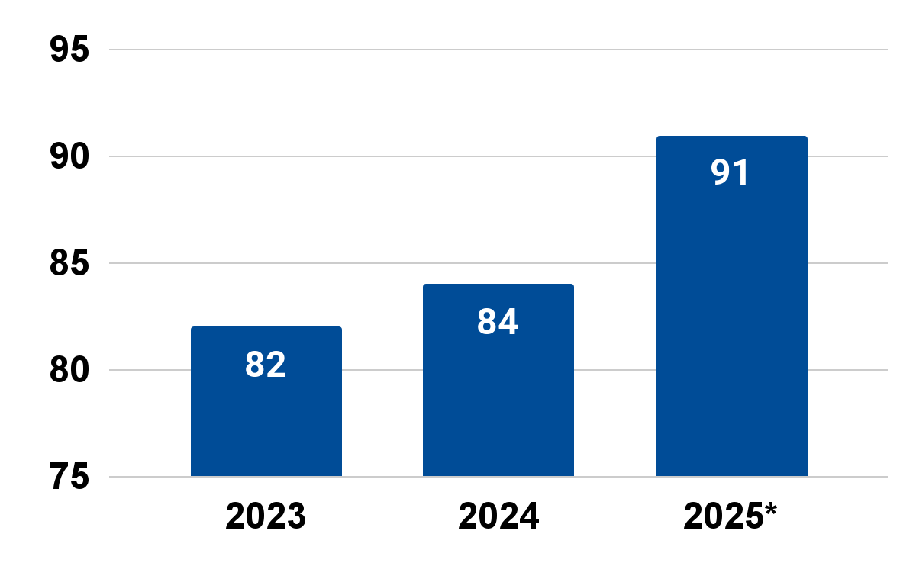
Performance-
Based Funding
*Tied with FSU for 3rd.

Slide 46
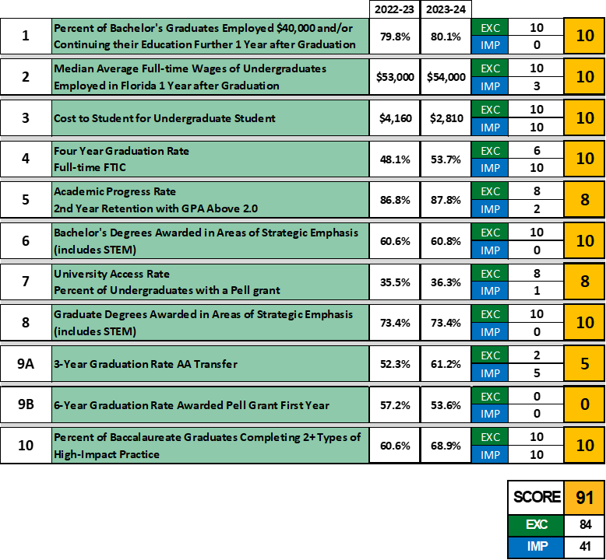
Metrics Summary

Slide 47
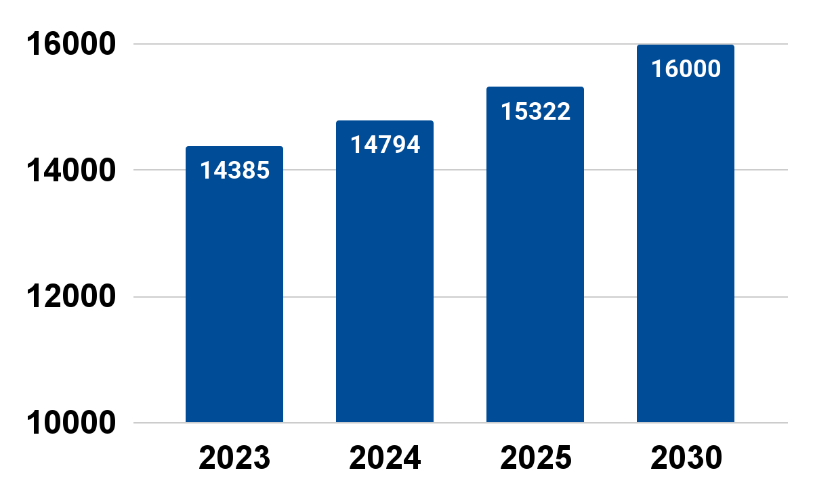
Students Enrolled

Slide 48
Fall 2025 Enrollment Stats compared to Fall 2024 on 8/15/2024:
Overall: +3% (+439)
Undergrad: +3% (+325)
Graduate: +3% (+160)
Non-Degree: -6% (-46)
The largest % increases are:
Returning FTIC: +10% (+335)
New Transfers (all categories): +9% (+95)
Returning Masters: +10% (+308)

Slide 49
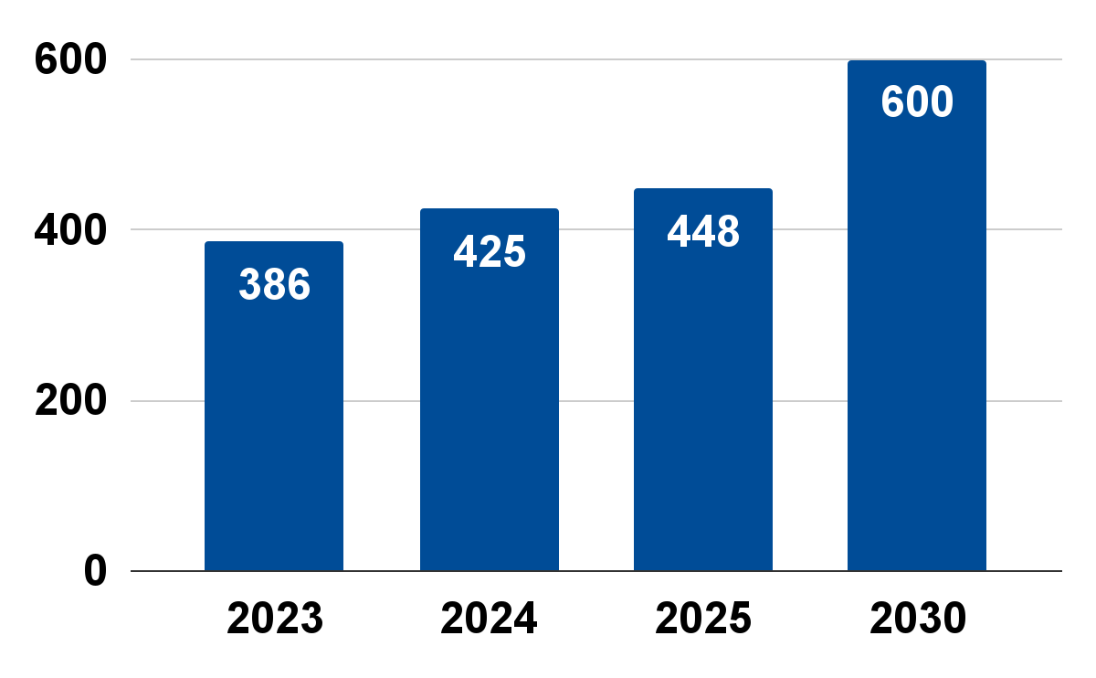
Full Time Faculty

Slide 50
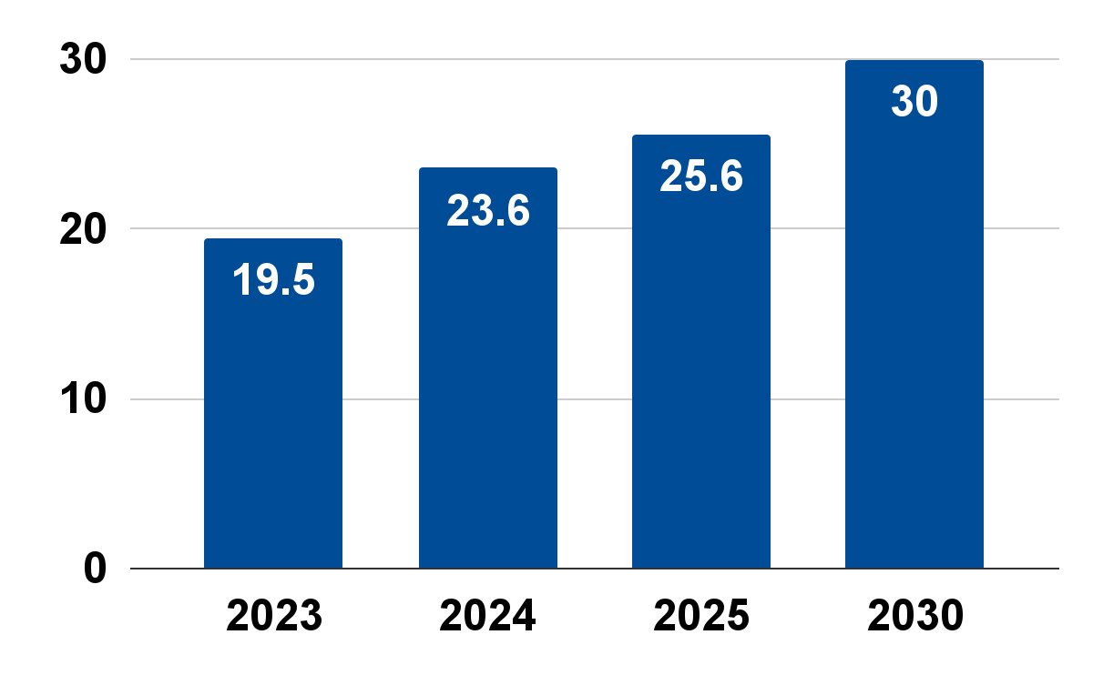
External Research Expenditures
In millions

Slide 51
RAFFLE!

Slide 52
Student Success
Self-Actualization
Desire to be everything one can be
5
Confidence
Prestige, feeling of accomplishment
4
Belonging
Friends, social groups, professional community
3
Safety Needs
Security, safety
2
Physiological Needs
Food, water, warmth, rest, shelter
1

Slide 53
Academic Affairs Annual Goals
www.menti.com

Slide 54
Student Success
1, 2, 3, 4, …

Slide 55

Student Success

Slide 56
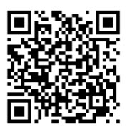
Student Success
2025 Faculty Canvas Gradebook Utilization Survey

Slide 57
Upcoming Events
August | September | October | November
8/29: Opening Home Football Game | 9/12: Townhall 9/18: President Diaz’s Ice Cream Social 9/26: Rite of Passage | 10/23: Provost’s Oktoberfest Social | 11/7: Rite of Passage 11/20: Faculty Awards Celebration

Slide 58
Concurrent Sessions
“Civil Disagreement Isn’t Dangerous: Tools for Teaching Contested Topics”
Presented by: Dr. Nicholas Buker, Dr. Kelly Carr, Ms. Aurora Osborn
Location: Mainstage Theater
“Expanding UWF’s Global Footprint Through Fellowship Opportunities”
Presented by: Ms. Claire Holderman
Location: Rolfs Music Hall
“Getting Students to Talk”
Presented by: Dr. Adam Blood
Location: Studio Theater
“QEP Reflect to Connect”
Presented by: Dr. Holley Handley
Location: Classroom 206

