Slide 1
UWF Building Emergency Coordinator Program
University Police Department

Slide 2
Training Objectives
Explain Building Emergency Coordinator (BEC) program
Clarify roles and responsibilities
Provide program ground rules
Discuss information and resources for BEC activities
Explain how to send email notification to YOUR building occupants

Slide 3
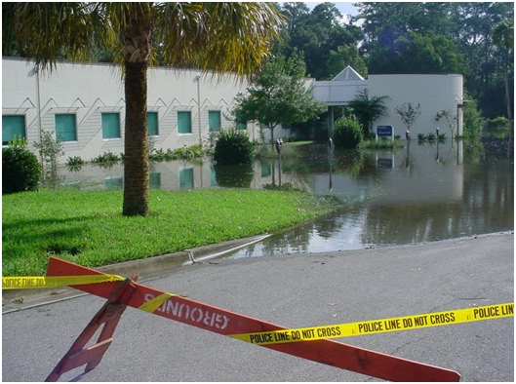
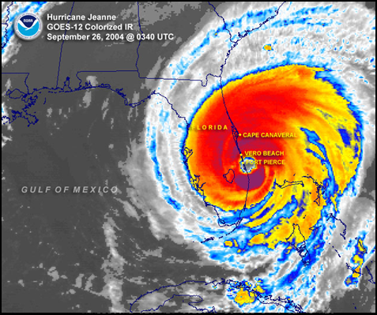
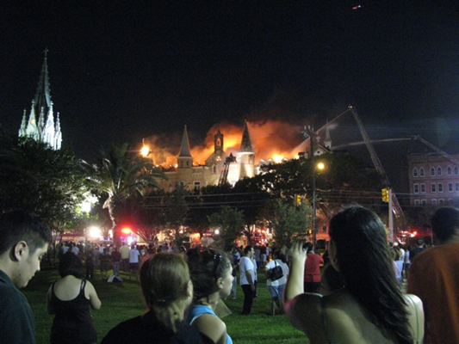
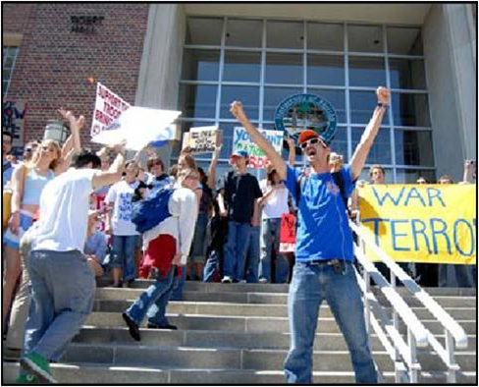
Why does UWF need BECs
Main campus includes ≈100 buildings on 1,600 acres plus several off-site facilities
Population of ≈ 16,500 faculty, staff and students
Diverse campus facilities including academic buildings, health center, daycares, secure research labs, apartment-style housing, theaters, etc.
You know your building better than anyone! Incidents can happen at any time.

Slide 4
What is the BEC Program
Establishes a point of contact for each department/college with assigned space in a building
Department/college assigns a primary and an alternate for occupied buildings, preferably someone who is on campus and in the building frequently.
Program is coordinated by the UWF Police Department, Emergency Management, and continued annually

Slide 5
BEC Roles and Responsibilities
Point of contact for safety & emergency preparedness information provided by UWF and other officials
Liaison with UWFPD Emergency Management and other officials in the event of an incident at your building
Act as an information conduit for issues related to Facilities issues, i.e., scheduled utilities outages and building maintenance problems
Provide damage information to UWF following a large-scale incident such as severe weather
Ensure completion of closure checklist and procedures before UWF closures
Read, follow and distribute BEC email messages to your building occupants
Encourage all building occupants download UWF Guardian. When you sign up for your profile, your account will automatically configure to UWF settings. Friends and family can download a general “RAVE Guardian” version of the app so they can be a part of your safety network. Available in Google play and the AppStore as Rave Guardian.

Slide 6
BEC Ground Rules
Do not put yourself or others in danger –
DON’T BE A HERO
Follow all announcements from UWF and local officials
Only wear BEC vest when there is a need to identify yourself performing BEC functions
(Contact UWF Police for a BEC Vest Ext. 2415)

Slide 7
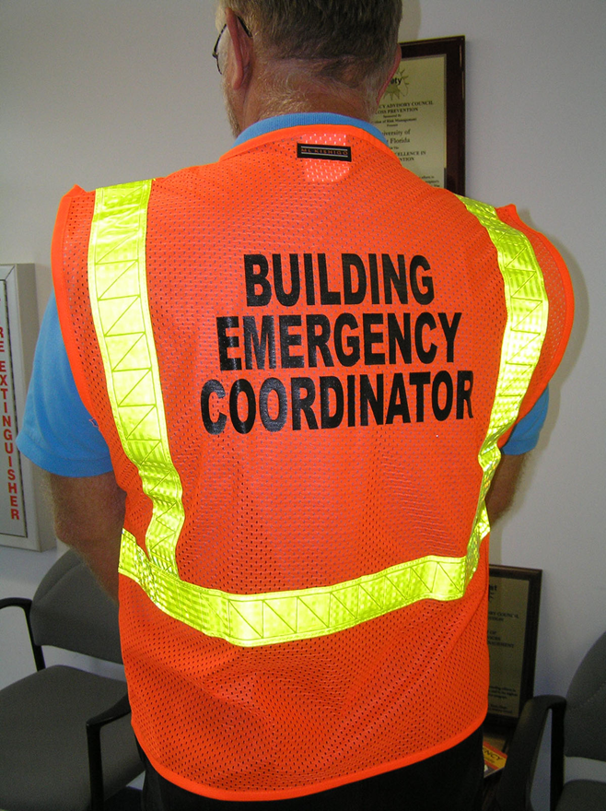
BEC Activities
Building Information
Building Threats
Know Basic Emergency Procedures
Facilities Liaison
Tropical/Severe Weather notification
UWF Closures
Damage Assessment
BEC Email distribution

Slide 8
Building Information
BECs should be knowledgeable of the following for your building:
Be knowledgeable of departmental space in building (critical issues, special circumstances, hazards, etc.)
Maintain contact information for restricted areas
Serve as conduit for emergency/preparedness information
Update appropriate emergency supplies such as hurricane closure materials
Coordinate with other BECs in your building including those from other departments/colleges

Slide 9
Building Threats
Bomb Threats
Suspicious objects
Receiving a threatening communication
Fire
Building evacuation
Fire Alarm Procedures
Shelter in Place
Secure building
Active Shooter

Slide 10
Emergency Procedures
^{Fire}
^{If you observe smoke or fire:}
Activate the fire alarm using a manual pull station.
EVACUATE the building and notify others as you exit.
^{Do not use elevators.}
Notify Emergency Personnel of persons with disabilities who are unable to evacuate.
As you exit, move to a safe distance. Do not reenter until notified by emergency personnel.
^{Active Shooter}
If a person enters the building with a weapon, if you hear gun fire or observe suspicious behavior, evacuate the building and move to a safe location if it is possible to do so.
Once you have evacuated the building, contact the UWF Police (850.474.2415) and provide as much information as possible.
If evacuation is not possible, find a secure area to hide until notified it is safe to leave by emergency personnel.
As a last resort, if confronted by the violent person you should attempt to incapacitate or disrupt the individual.
^{Medical Emergency}
Contact the UWF Police (850.474.2415), provide information on the type of injury and the campus location of the victim.
Provide first aid or medical assistance if required.
Remain with the injured individual until help arrives.
If the injured person is unconscious and not breathing start CPR, if trained.
^{Shelter-in-Place}
During the event of severe weather, tornado warning or a hazardous chemical spill:
The University will activate appropriate methods of emergency notification.
Immediately seek refuge inside the nearest building.
Find a safe location in the lowest level,
preferably in interior hallways or rooms away from glass windows.
Remain in safe location until instructed by UWF authorities it is safe to leave the building.
Power Outage or Utility Failure
Contact Facilities Management, Work Order Control Center (850.857.6000) to report a utility failure.
If there is a possible danger to building occupants, exit the building and call the UWF Police (850.474.2415).
Notify emergency personnel of persons with disabilities who are in the building and if there are any individuals trapped in an elevator.
The UWF administration will decide on the status of classes based on the situation.
^{Hazardous Materials}
If a chemical spill occurs within a campus building, immediately notify the UWF Police (850.474.2415).
If a chemical spill occurs outside of a building or from an off campus source, follow shelter-in- place procedures.
In either case, notify the UWF Police (850.474.2415) if you have been exposed to a chemical.
The University administration will provide instructions through the University’s Emergency Notification System.
^{Bomb Threat}
If you receive communications that an explosive device may be on campus:
Get as much information from the caller as possible.
Call the UWF Police (850.474.2415).
If told to evacuate by UWF Police, do so and move away from the building.
^{Suspicious Package}
If you observe a suspicious object, which may be a potential bomb, DO NOT HANDLE THE OBJECT.
Contact the UWF Police (850.474.2415). Provide as much information as possible.
Evacuate the area and await instructions from the UWF Police.

Slide 11
Facilities Liaison
Provides a point person for Facilities
Provides information to building occupants
Notify Facilities of building issues
Call Work Order Control Center at Ext. 6000

Slide 12
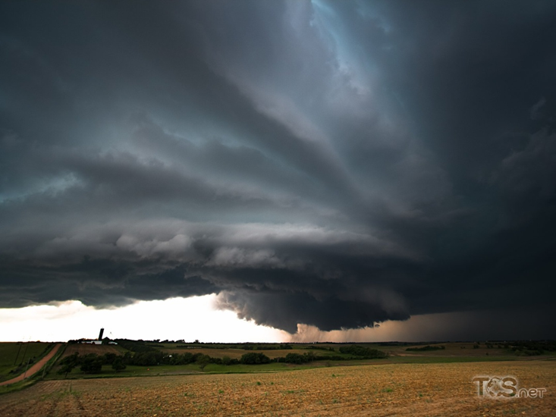
Severe Weather – General Information and Weather Monitoring
Resources for monitoring severe weather:
National Weather Service (NWS), Mobile, AL:
https://www.weather.gov/mob
Issues Watches and Warning for area
Understand weather watches and warnings
Watch means hazardous weather is possible
Warning is issued when hazardous weather is occurring, and pose a risk to life or property.
NOAA weather radio

Slide 13
Tropical Weather and Hurricanes
UWF follows forecasts issued by the National Hurricane Center – https://www.nhc.noaa.gov/
Campus Emergency Operations Center activated if needed
BECs should monitor tropical weather information throughout hurricane season (June 1 - November 1)
NWS-Mobile holds webinars for Local EM personnel. You will be sent the presentations directly

Slide 14
UWF Closures-Weather Related
UWF closure decision made by UWF President or her designee
Issues coordinated with local officials via Escambia County Emergency Operations Center
UWF closure is really suspension of normal activities. UWFPD, Facilities, etc. continue to operate
Shelters
B4 - Resident students only
B72 (HLS) & B13 - Public Shelter

Slide 15
UWF Closures – BEC Activities
Ensure completion of closure checklist(s) –
Office closure checklist
Lab/research area checklist
Secure vehicles
Monitor information from UWF administration regarding operational schedules

Slide 16
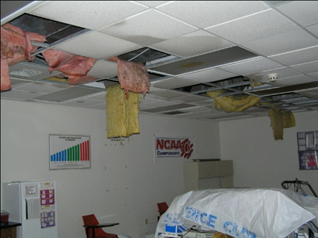
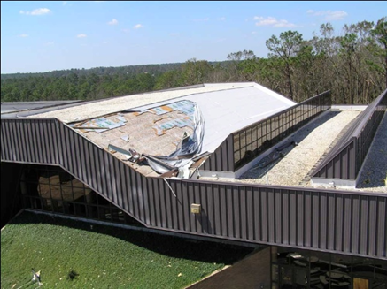
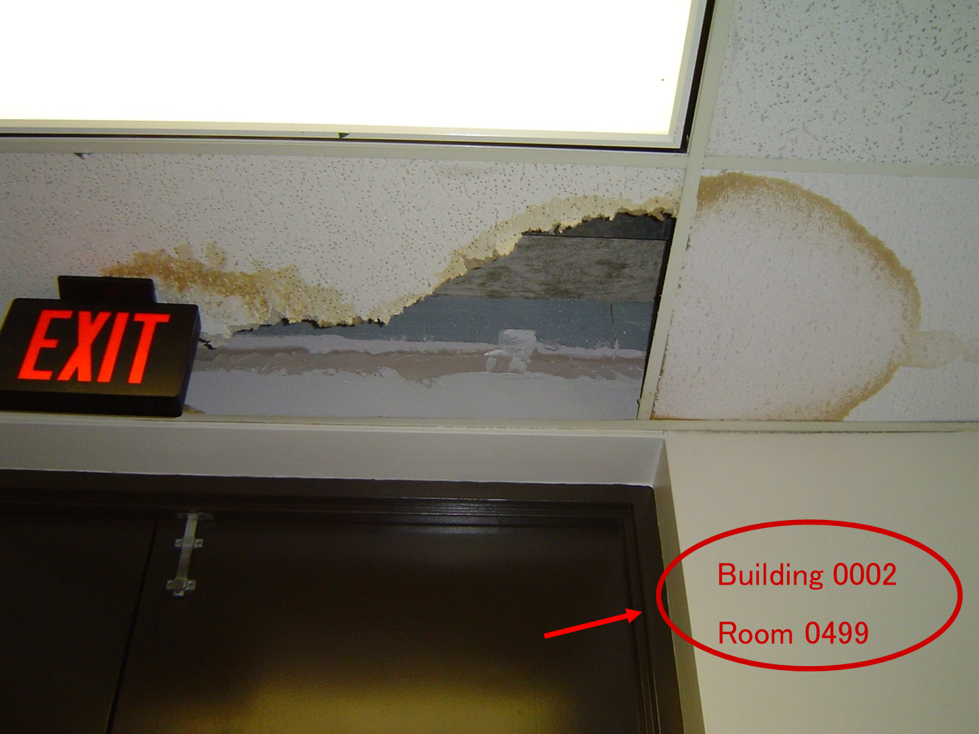
Damage Assessment
Only when needed and/or specifically requested after a severe weather event.
Complete an assessment form for either Building exterior and/or Rooms (interior)
Take pictures of damage and include building & room number in image
Directly contact Work Control, Ext. 6000, for urgent or critical items

Slide 17
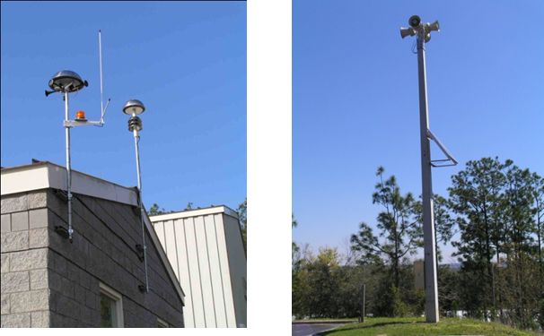
UWF Emergency Notification
Important UWF Emergency Communications
Multimodal approach to campus-wide notification:
Text Messaging – Sign up for mobile alert and encourage staff and students to sign up
Email
Twitter
Facebook
Sirens
Lightning Prediction System
UWF Homepage & WUWF radio (official source for information)
Argo Alert notification speakers installed in numerous campus building
Important for BECs to provide your current emergency contact information to UWFPD as soon as possible.
If BEC personnel change, please notify UWFPD immediately!

Slide 18
BEC Message Composer
It may be necessary for you to contact all the employees who reside in the buildings under your responsibility.
In MyUWF, the Message Composer app can be used to send a mass email to building occupants under the “Building Coordinators” population.
Visit the Confluence page provided here to learn how to use the Message Composer in your role as a BEC.
Using Message Composer in Your BEC Role

Slide 19
Questions?
University Police Department
Sandra Bermejo, Sr. Communications Operator
Building 94
Ext. 7227
sbermejo@uwf.edu
David Faircloth, Captain
Building 94
Ext. 2415
dfairclo@uwf.edu

