Slide 1
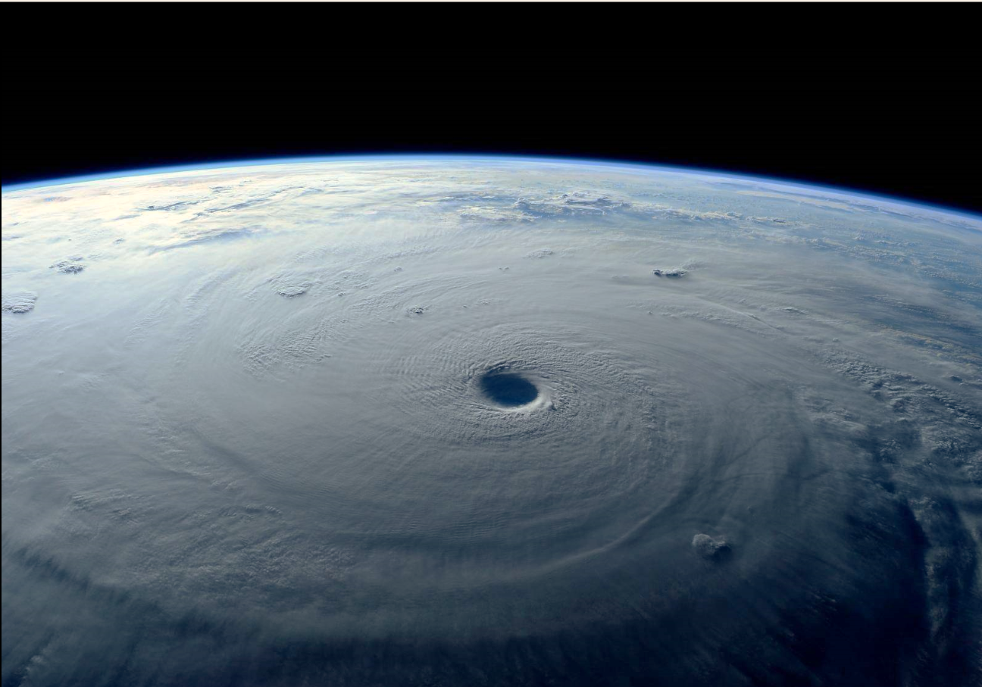
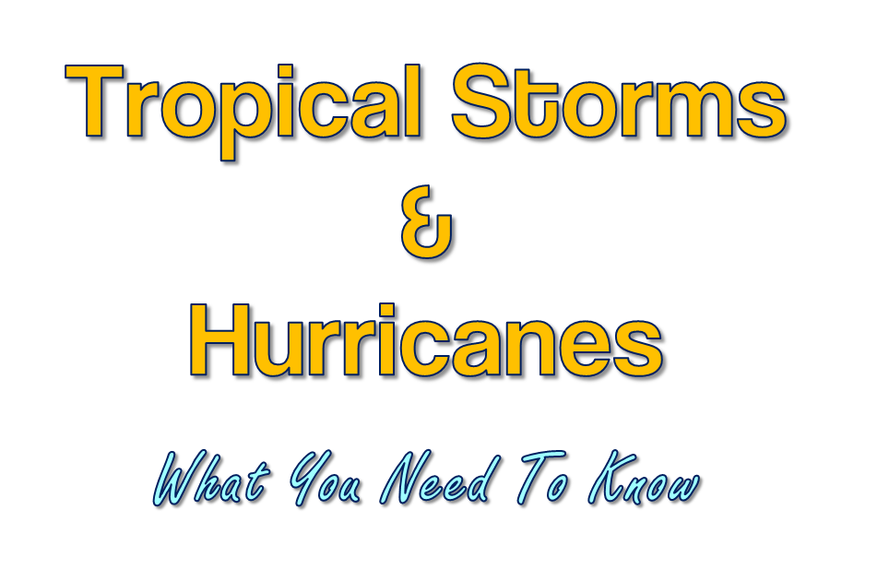
Don Shepherd
Senior Forecaster
Tropical Outreach and Preparedness Focal Point
National Weather Service
Mobile/Pensacola

Slide 2
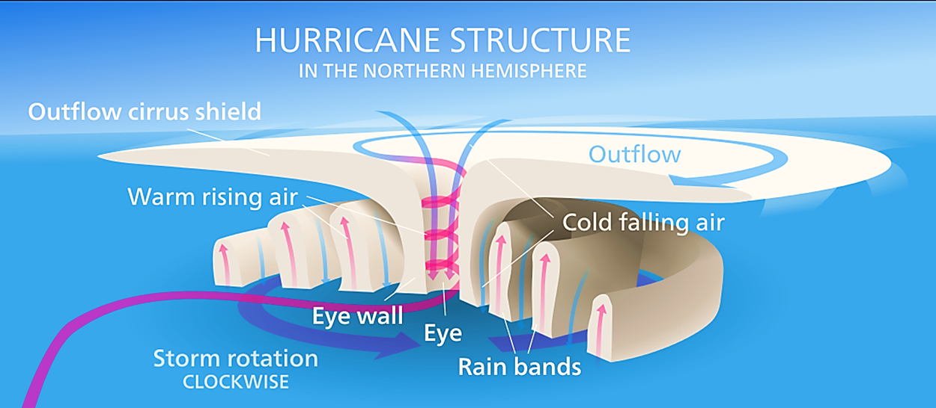
What is a Tropical Cyclone?
A warm-core, non-frontal, synoptic scale cyclone originating over tropical or subtropical waters with organized deep convection and a closed surface wind circulation around a well-defined center

Slide 3
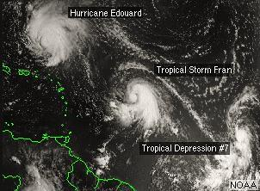
Tropical Definitions
Tropical Depression
Tropical cyclone with maximum sustained surface wind of 38mph (34 knots) or less
Tropical Storm
Maximum sustained surface winds of 39-73 mph (34-63 knots)
Hurricane
Maximum sustained surface winds 74+ mph (64+ knots)

Slide 4
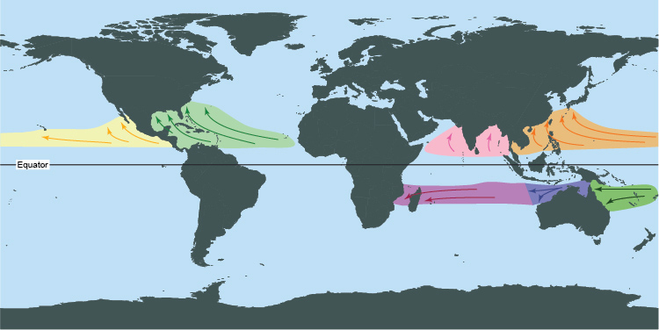
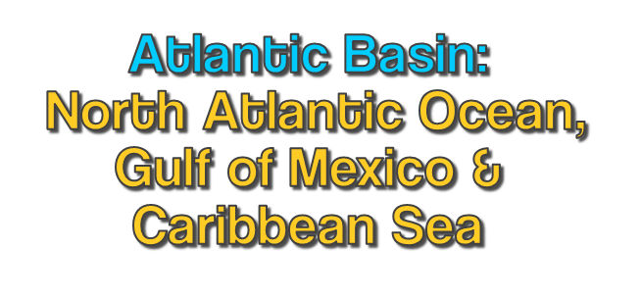
Tropical Cyclone: Source Regions
There are 7 ocean basins where tropical cyclones form on a regular basis

Slide 5
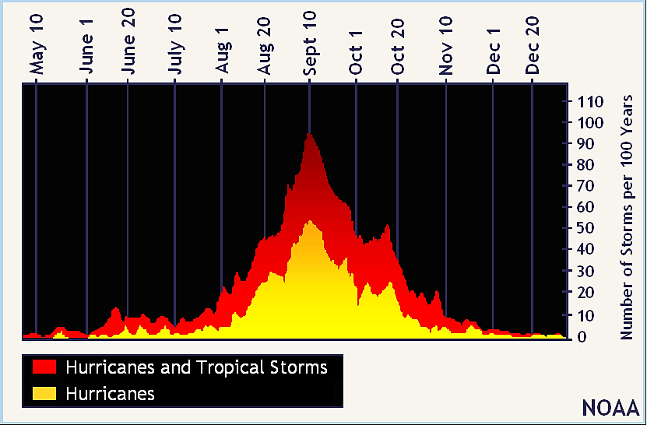
General Climatology
Atlantic Hurricane Season June 1st – November 30th
Average Peak of Season Date September 10th

Slide 6
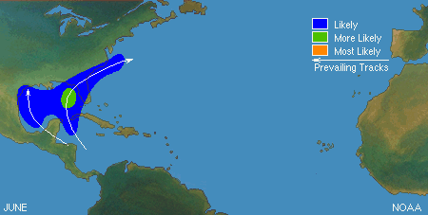
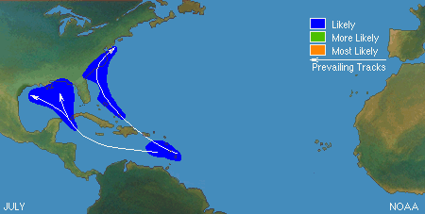
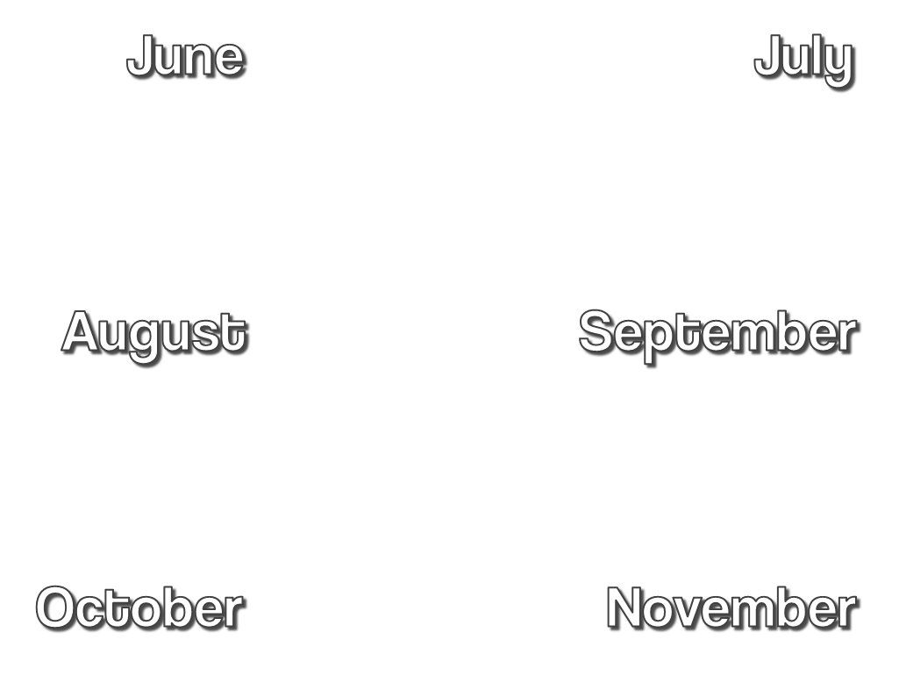
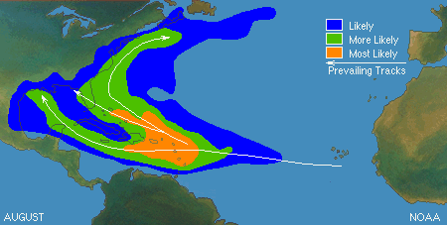
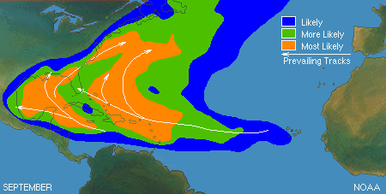
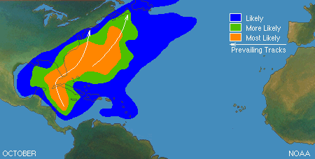
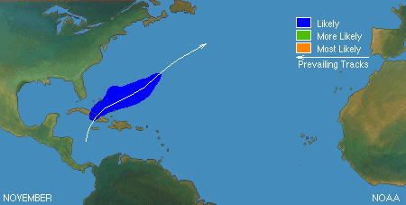
Climatological Areas of Origin

Slide 7
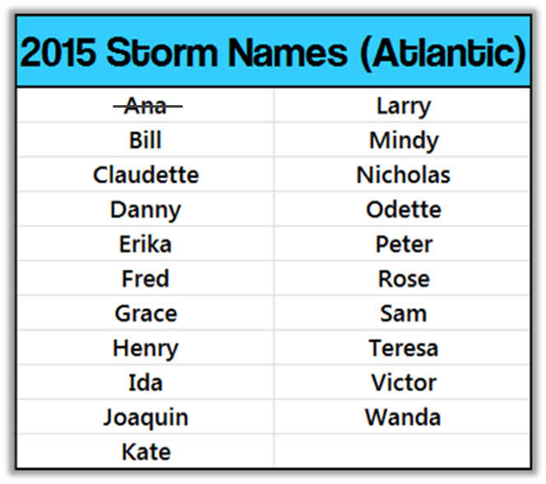
2015 Hurricane Season Outlooks
On Average:
11 named storms each season in the Atlantic basin
6 of those named storms become hurricanes
3 of which will become major hurricanes (Cat 3+)
2015 Hurricane Season Forecast from NOAA not released…yet.
Several universities and private researchers issue their own hurricane season outlooks
Colorado State University climatologists: 7 named storms, 3 hurricanes & 1 major hurricane

Slide 8
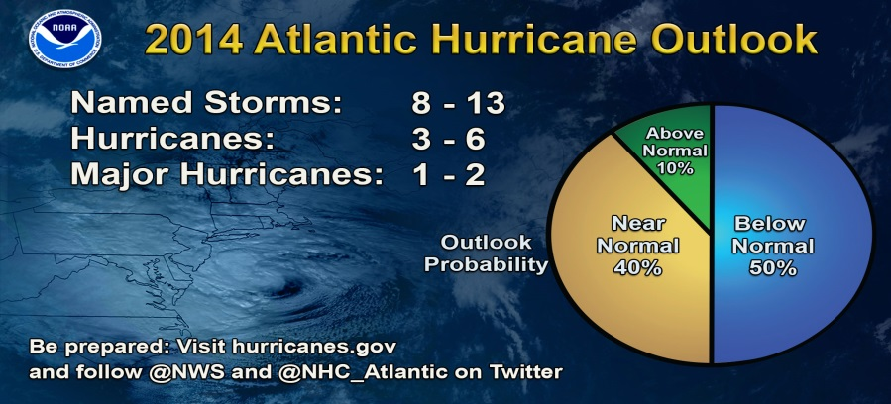
2015 Hurricane Season Outlooks
On Average:
11 named storms each season in the Atlantic basin
6 of those named storms become hurricanes
3 of which will become major hurricanes (Cat 3+)

Slide 9
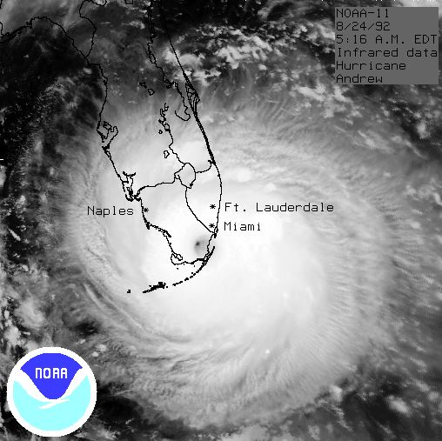
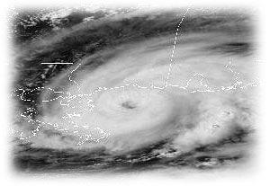
2015 Hurricane Season Outlooks
Below average DOES NOT mean a major hurricane will not occur
It is important to be prepared and not become complacent
IT ONLY TAKES ONE hurricane landfall in your area to make it an active season for you!!

Slide 10
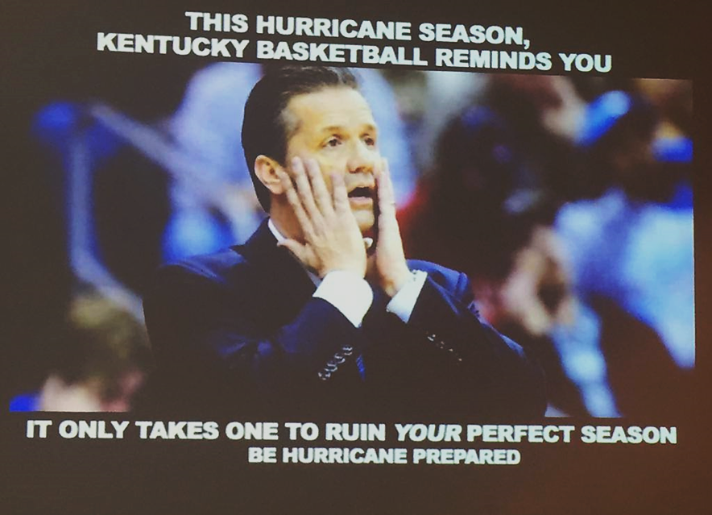
Or, as another example…

Slide 11
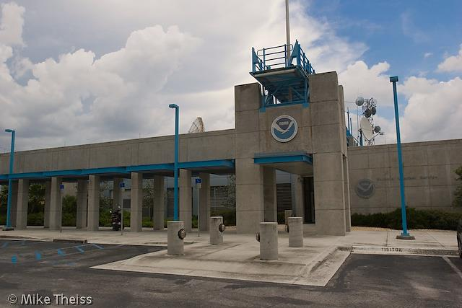
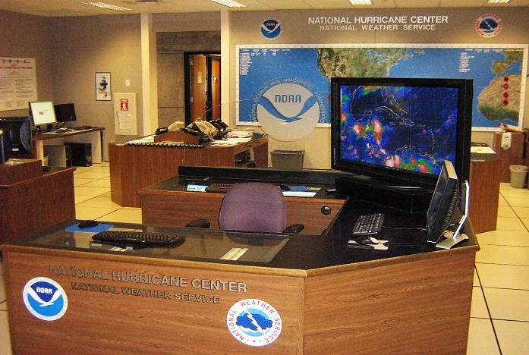
How the Forecast Process Works
The Tropics are monitored 24 hours a day by the National Hurricane Center (NHC) in Miami, FL
NHC plays a vital role for the National Weather Service –
Responsible for monitoring & forecasting of ALL tropical cyclones (and disturbances) in the Atlantic Basin (Atlantic, Caribbean Sea and the Gulf of Mexico)
Responsible for issuing Watches, Warnings & Advisories

Slide 12
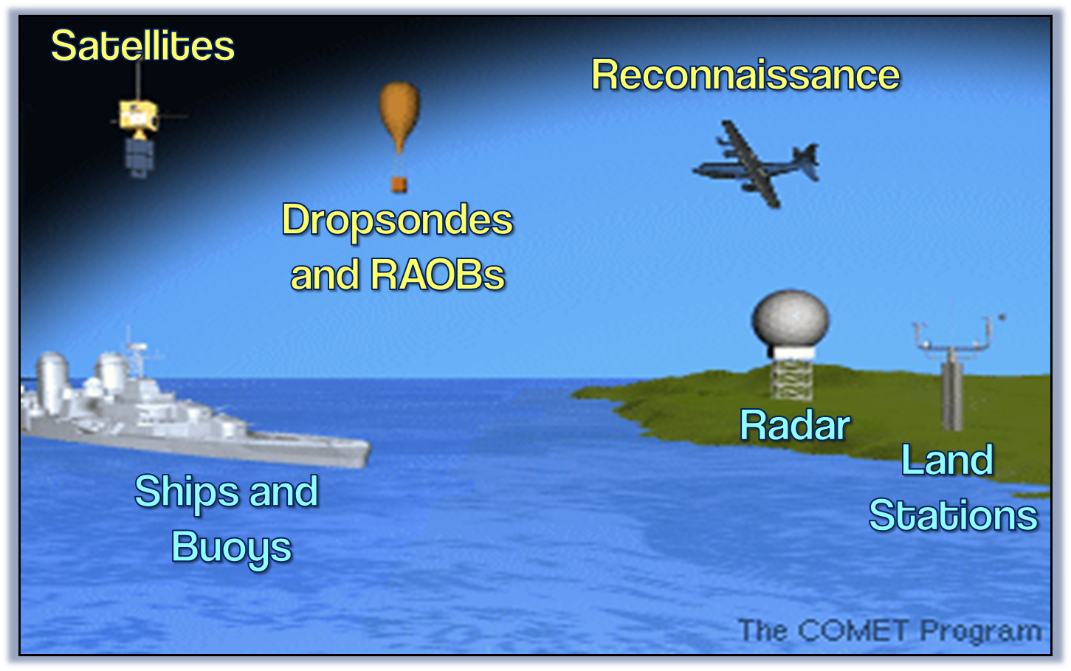
Monitoring the Tropics

Slide 13
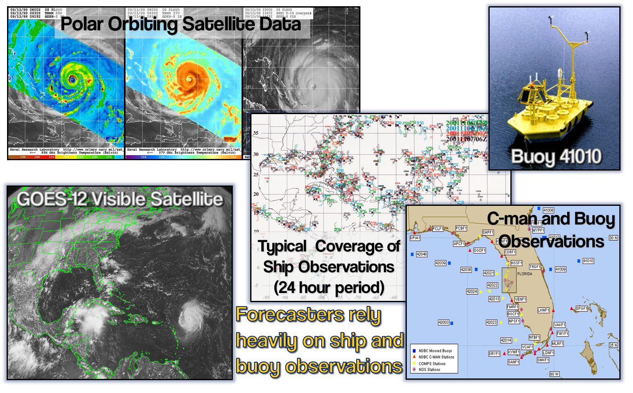
Far From Land:
Notes:
Microwave technology can peer into a storm’s structure

Slide 14
Approaching Land:

Slide 15
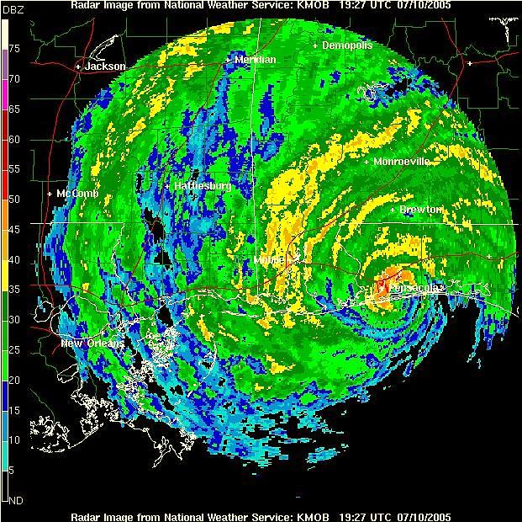
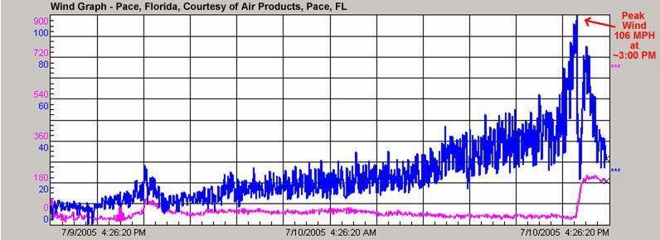
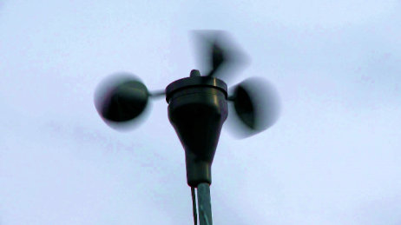
Near & Over Land:

Slide 16
Forecast Process
All of that data is input into a super computer, which runs numerous weather forecast scenario model outputs for the storm
NHC Forecasters use all this information to make the most accurate forecast possible.
They provide pertinent information as well as any necessary Watches, Warnings & Advisories.
Included in NHC products is such information as
Probabilistic Storm Surge (P-Surge) Potential Storm Surge Flooding Map (Inundation Map) NEW! Prototype Storm Surge Watch/Warning Map Wind Speed Probabilities

Slide 17
Forecast Process
WATCH
WARNING
Tropical storm and/or hurricane conditions are POSSIBLE in Watch area
Issued up to 48 hours in advance of tropical storm force winds
Tropical storm and/or hurricane conditions are EXPECTED in Warning area
Issued up to 36 hours in advance of onset of tropical storm force winds
Hurricane preparedness activities become difficult once winds reach tropical storm force. Watches & Warnings are issued in advance of onset of tropical storm force winds, 39-73mph

Slide 18
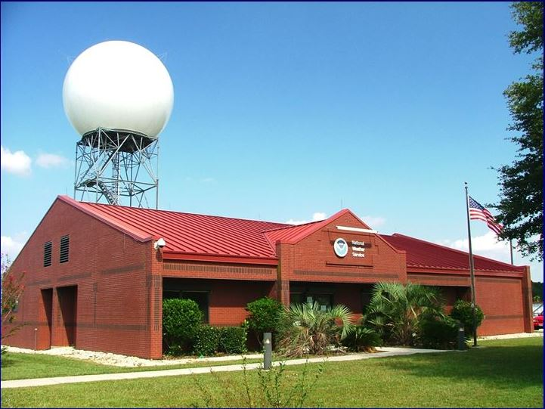
Forecast Process: NWS Mobile
NWS Mobile receives general NHC hurricane forecast information every 6 hours via Hurricane Hotline, Advisories & Discussions
Information is then specialized for our area & added to the Hurricane Local Statement (HLS) & NEW! Watch/Warning Statement (TCV)
Provide briefings to our emergency managers & tv media on what to expect
New briefing package for each new NHC advisory
Provided every 6 hours (3 hours as it nears the area & makes landfall)

Slide 19
Forecast Process: Summary
Emergency Management
National Weather Service Mobile/Pensacola
National Hurricane Center
Broadcast Media
Internet Weather Radio Cellphone
Notes:
Importance of partnerships. We are NOT on tv. Work closely with these agencies…or the public can get the information directly from us.

Slide 20
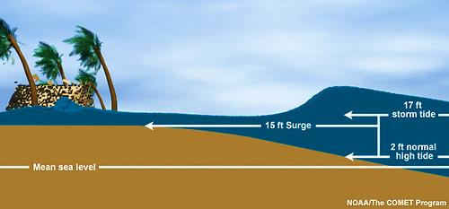
Tropical Hazards
Storm Surge –
Abnormal rise of water generated by a storm, over & above the predicted astronomical tides
Produced by water pushed toward shore by force of wind
Historically the greatest threat to life & property from a tropical storm or hurricane

Slide 21
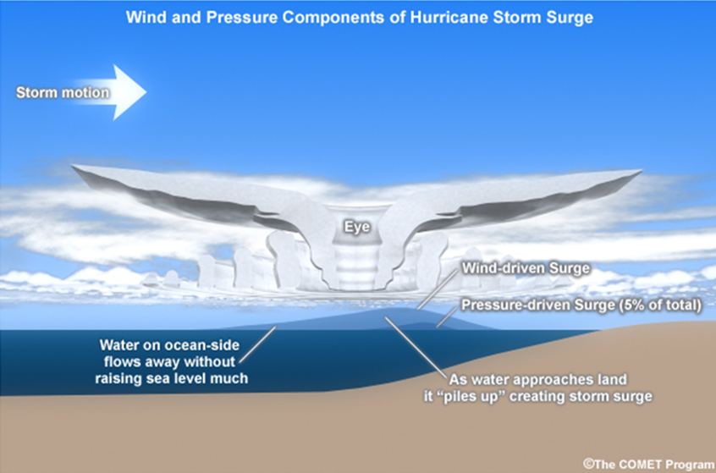
Storm Surge
Storm surge is dependent on a number of factors
Intensity
Size
Speed
Track
Coastal Configuration

Slide 22
Storm Surge
Katrina (Cat 3)
Ike (Cat 2)
Sandy (Cat 1)
Isaac (Cat 1)
Charley (Cat 4)

Slide 23
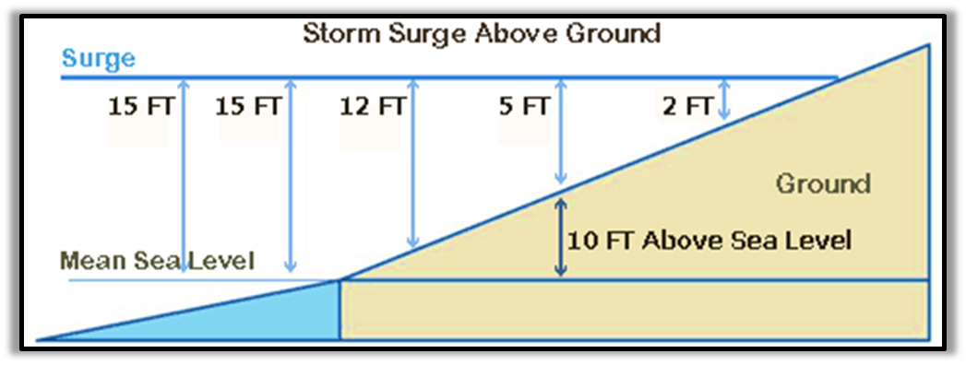
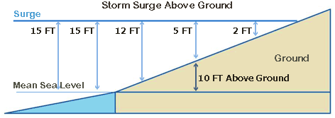
Tropical Hazards
Total storm surge inundation is most impactful for decision makers
Inundation – how high the water could reach into land areas. This takes into account the tide, land elevation, storm intensity, size & structure, as well as the track, angle of approach & forward speed
Inundation from storm surge is expressed in height above ground level or AGL
You MUST know your elevation!!

Slide 24
Potential Storm Surge
Issued by NHC for areas along the coast that are at risk of storm surge from the tropical cyclone
Provides information on storm surge associated with the tropical cyclone
Highlights areas where inundation from storm surge could occur & the height above normally dry ground (in feet) the water could reach
Depicts inundation levels that have a 10% chance of being exceeded
Think of it as a representation of the WORST-CASE SCENARIO for any location

Slide 25
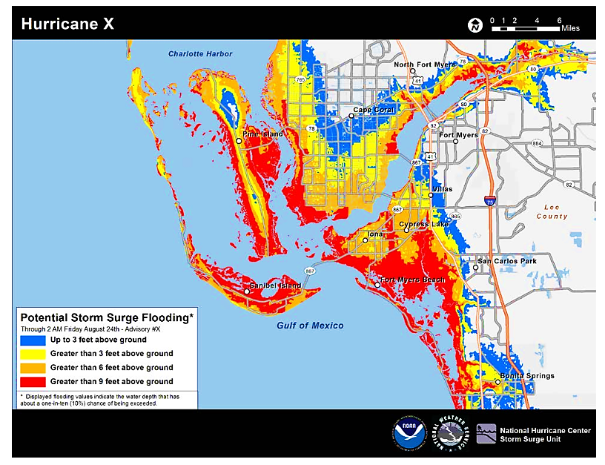
Potential Storm Surge
Issued with the
initial Hurricane Watch/Warning
Every 6 hours with new advisory
Based on latest forecast track & intensity
Available 45-60 minutes after issuance of the advisory
Notes:
Takes into account forecast errors
http://www.nhc.noaa.gov/surge/StormSurgeCanBeDeadly10tips-trifold.pdf http://www.nhc.noaa.gov/surge/StormSurgeCanBeDeadly10tips-single.pdf

Slide 26
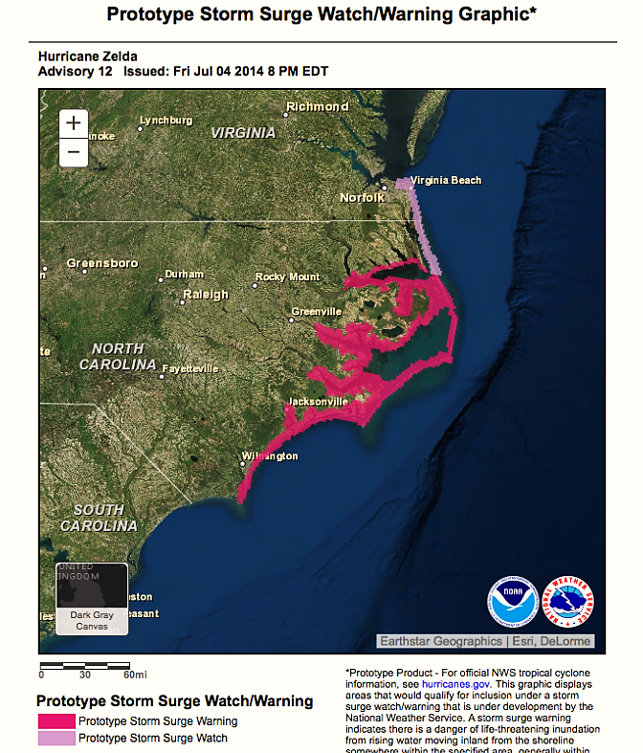
Potential Storm Surge
Primary audience is the general public
Highlights the areas with a SIGNIFICANT RISK of life-threatening surge
Does not provide any quantitative inundation levels
Risk areas referenced in the Hurricane Local Statement & the Hazards section of NHC Public Advisory

Slide 27
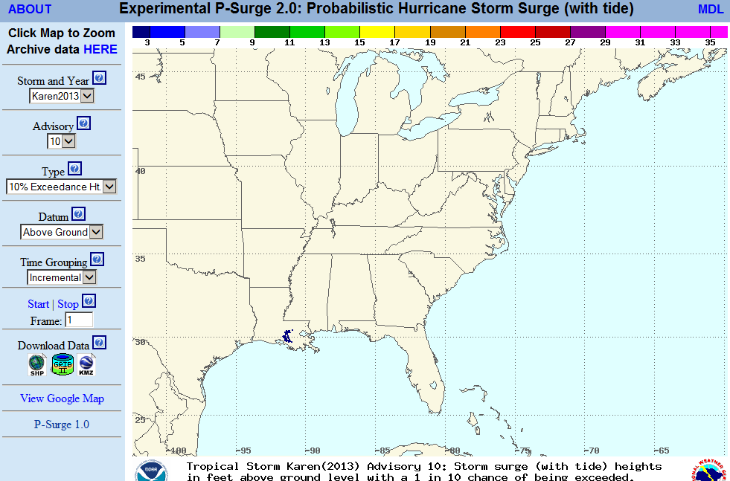
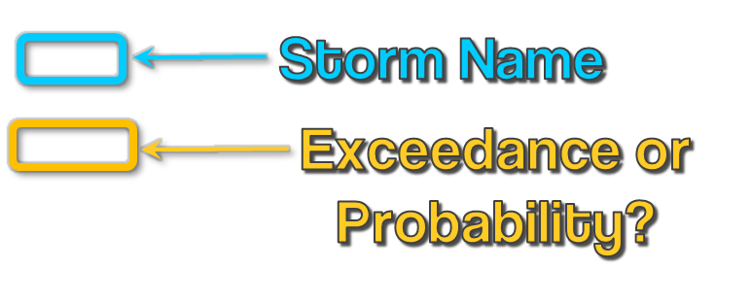
Probabilistic Storm Surge
P-Surge accounts for location, forward speed (timing), intensity (pressure), & size of storm
Evaluated by either the exceedance height or probability of a certain height at specific locations along the coast
Accessible after each advisory nws.noaa.gov/mdl/psurge2.0

Slide 28
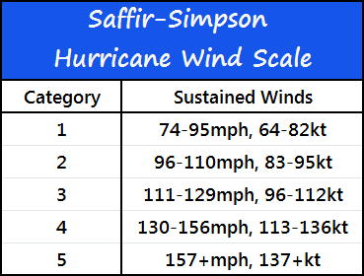
Tropical Hazards
Tropical cyclones produce dangerous & destructive winds
Atlantic hurricanes are classified into 5 categories according to the Saffir-Simpson Hurricane Wind Scale
This scale estimates the potential for property damage according to the hurricane's sustained wind speed
Hurricane force winds
can extend well inland

Slide 29
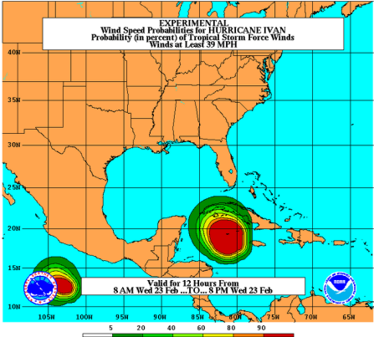
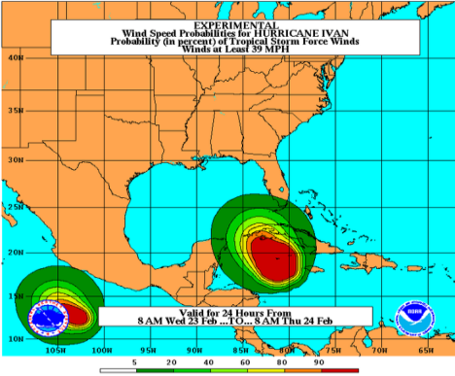
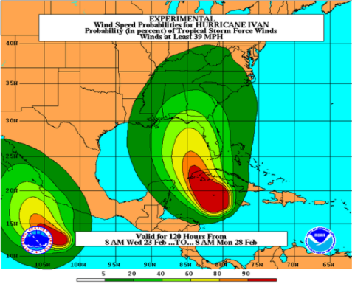
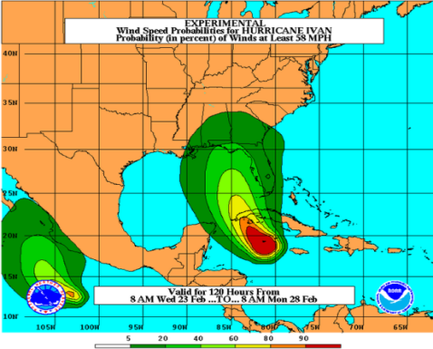
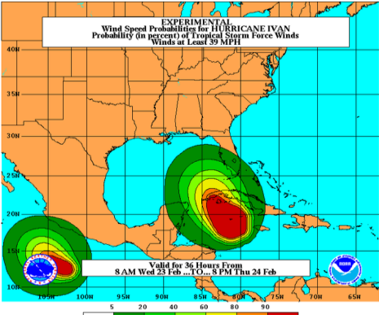
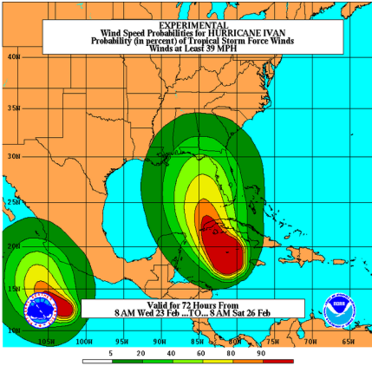
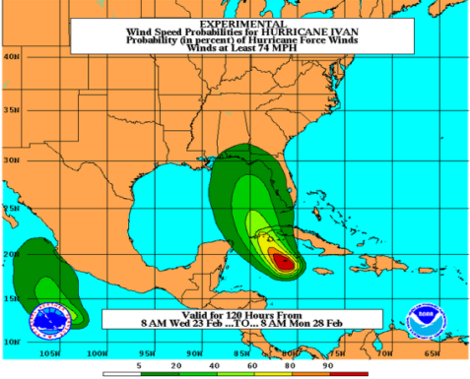
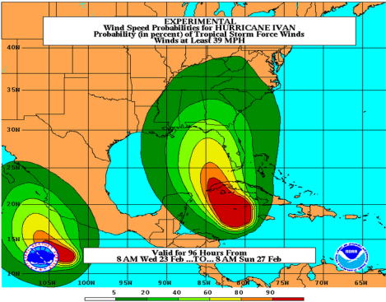
Wind Speed Probabilities
Cumulative: 34kt, 50kt, 64kt Through 120 hours
Incremental: 34kt, 50kt, 64kt
Every 12 hours
Gives Onset Information
12hr
24hr
34kt
50kt
36hr
72hr
64kt
96hr
120hr

Slide 30
Wind Speed Probabilities
Cumulative: 34kt, 50kt, 64kt
Through 120 hours
Incremental: 34kt, 50kt, 64kt
Every 12 hours
Gives Onset Information
34kt
64kt
50kt
12hr
24hr
36hr
72hr
96hr
120hr

Slide 31
Tropical Hazards
Inland flooding resulting from heavy rains has been the #1 killer from tropical systems for most of the past 2 decades
Historic storm surge associated with Hurricane Katrina in 2005 changed that statistic.
Inland flooding is still by far the 2nd most dangerous hazard associated with any tropical cyclones

Slide 32
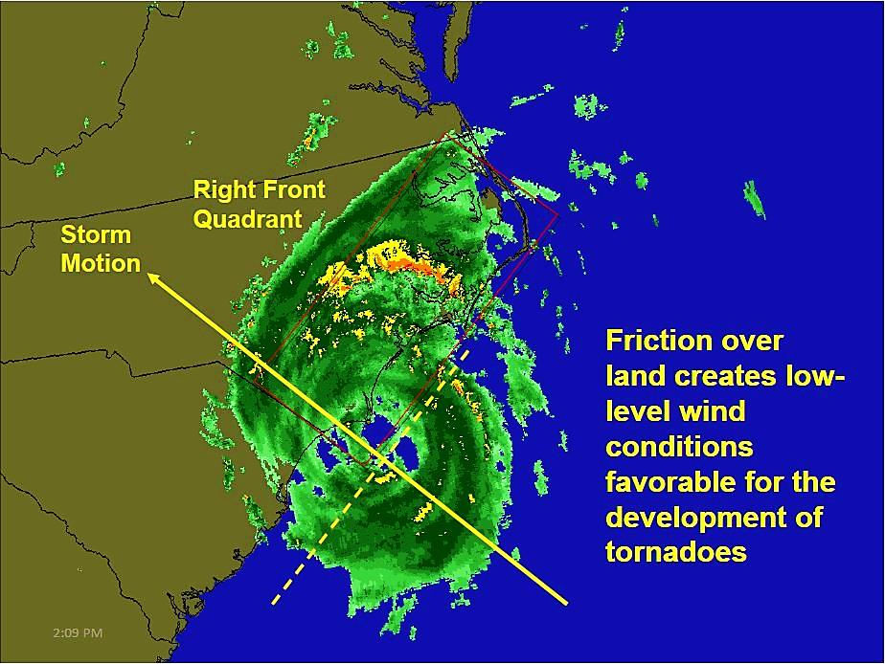
Tropical Hazards
Tornadoes produced by tropical cyclones are typically weak EF0 to EF1 & short-lived
Nearly 70% of landfalling hurricanes (1948-2000) spawned at least 1 tornado, 40% spawned 3+ tornadoes…while some hurricanes even produced tornado outbreaks
Hurricane Ivan produced 117 tornadoes!!
These types of tornadoes typically occur in the outer rain bands

Slide 33
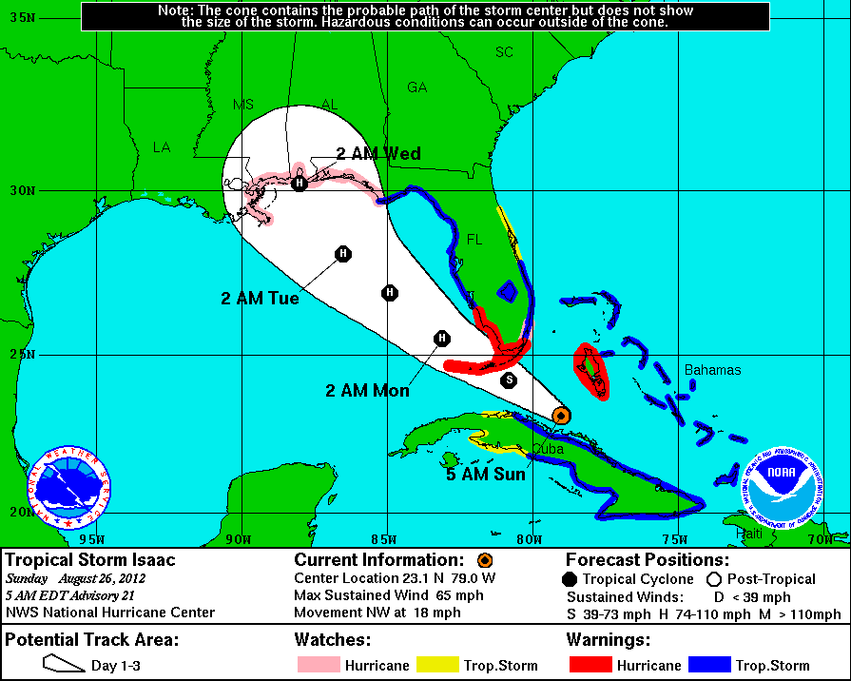
Forecast Cone
The cone represents the probable track of the CENTER of a tropical cyclone
Based on historical track forecasts errors over the past 5 years
Track of the tropical cyclone is expected to remain in the cone ~60-70% (or 2/3rds) of the time

Slide 34
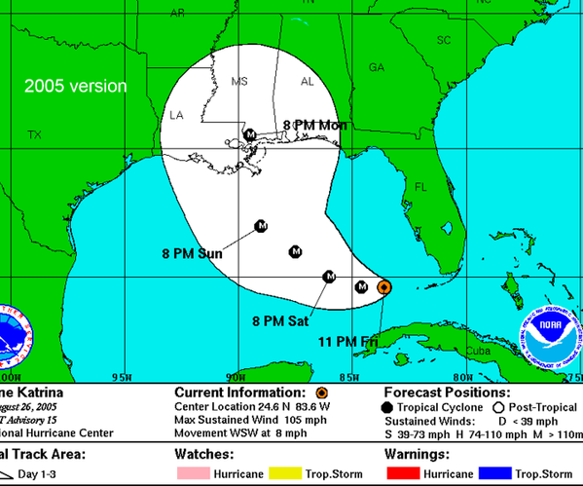
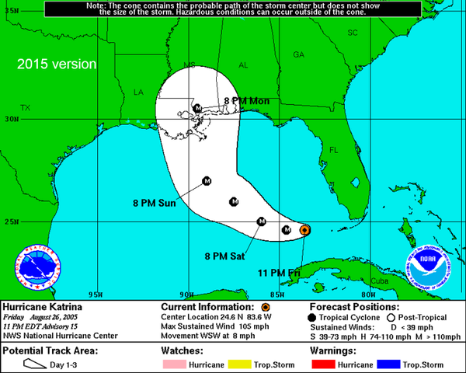
Forecast Cone

Slide 35
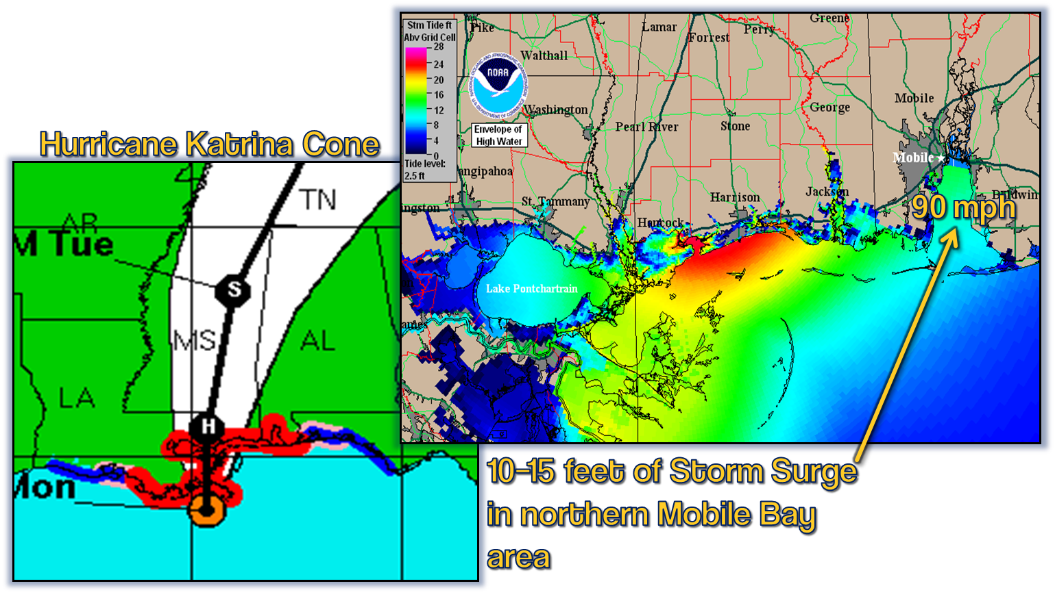
Some ‘Cone’siderations

Slide 36
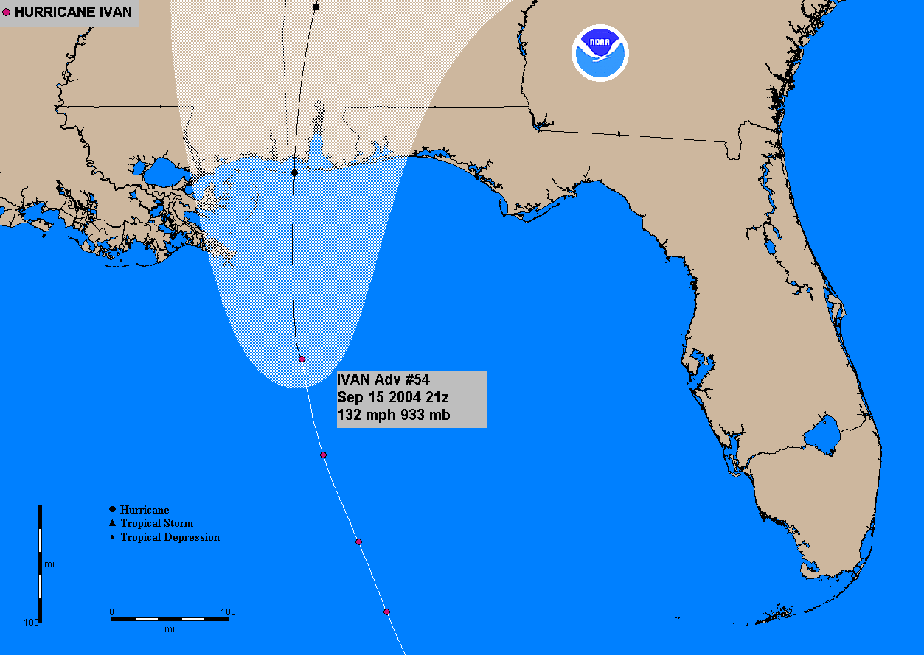
Hurricane Ivan: Advisory

Slide 37
Hurricane Ivan: Surge

Slide 38
Hurricane Ivan: Track

Slide 39
Hurricane Ivan: Surge

Slide 40
Hurricane Ivan: P-Surge

Slide 41
Ways To Get The Warning!
MULTIPLE WAYS of getting the warning!
Weather Radio
Television
Websites weather.gov/mob
Cellphone Alerts
Social Media
Notes:
Raises your awareness of severe storms…so you can turn on TV or weather radio to get more information!!

Slide 42
Ways To Get The Warning!
Newer phones will alert you of warnings in your area with a unique ring tone & vibration.
Carriers alert by GPS location or county
You are NOT charged for text-like alerts (automatically enrolled to receive)
Notes:
Wireless Emergency Alert (WEA) …Unique ring tone & vibration
Subscribe to a text messaging system or phone service for your home or cell phone that will relay the warning (Offered by local tv stations…often FREE!)

Slide 43
Tropical Page

Slide 44
Impact Graphics

Slide 46
**TIPS**
Scroll to the bottom of the Tropical Page for these links!

Slide 47
Social Media Dashboard

Slide 48
Social Media Dashboard

Slide 49
Contact NWS Mobile/Pensacola
Phone:
1-800-284-9059
Web:
weather.gov/mob
Facebook:
facebook.com/NWSMobile
Twitter: Hashtags we monitor:
twitter.com/NWSMobile #mobwx #alwx #mswx #flwx
YouTube:
YouTube.com/NWSMobile
Notes:
Hashtags!!

Slide 50
Don’t Let This Happen To You!

